Slide 1
Getting started with ENDNOTE Compiled by Helene van der Sandt

Slide 2
CITE WHILE YOU WRITE

Slide 3
On the Word document, click here

Slide 4
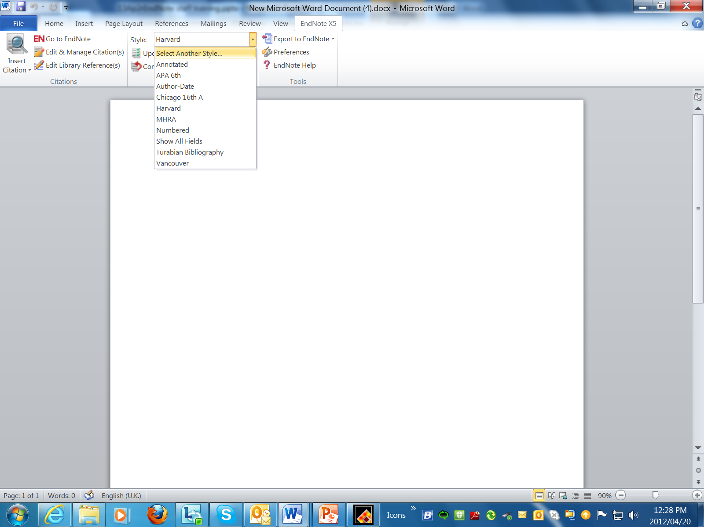

Slide 5
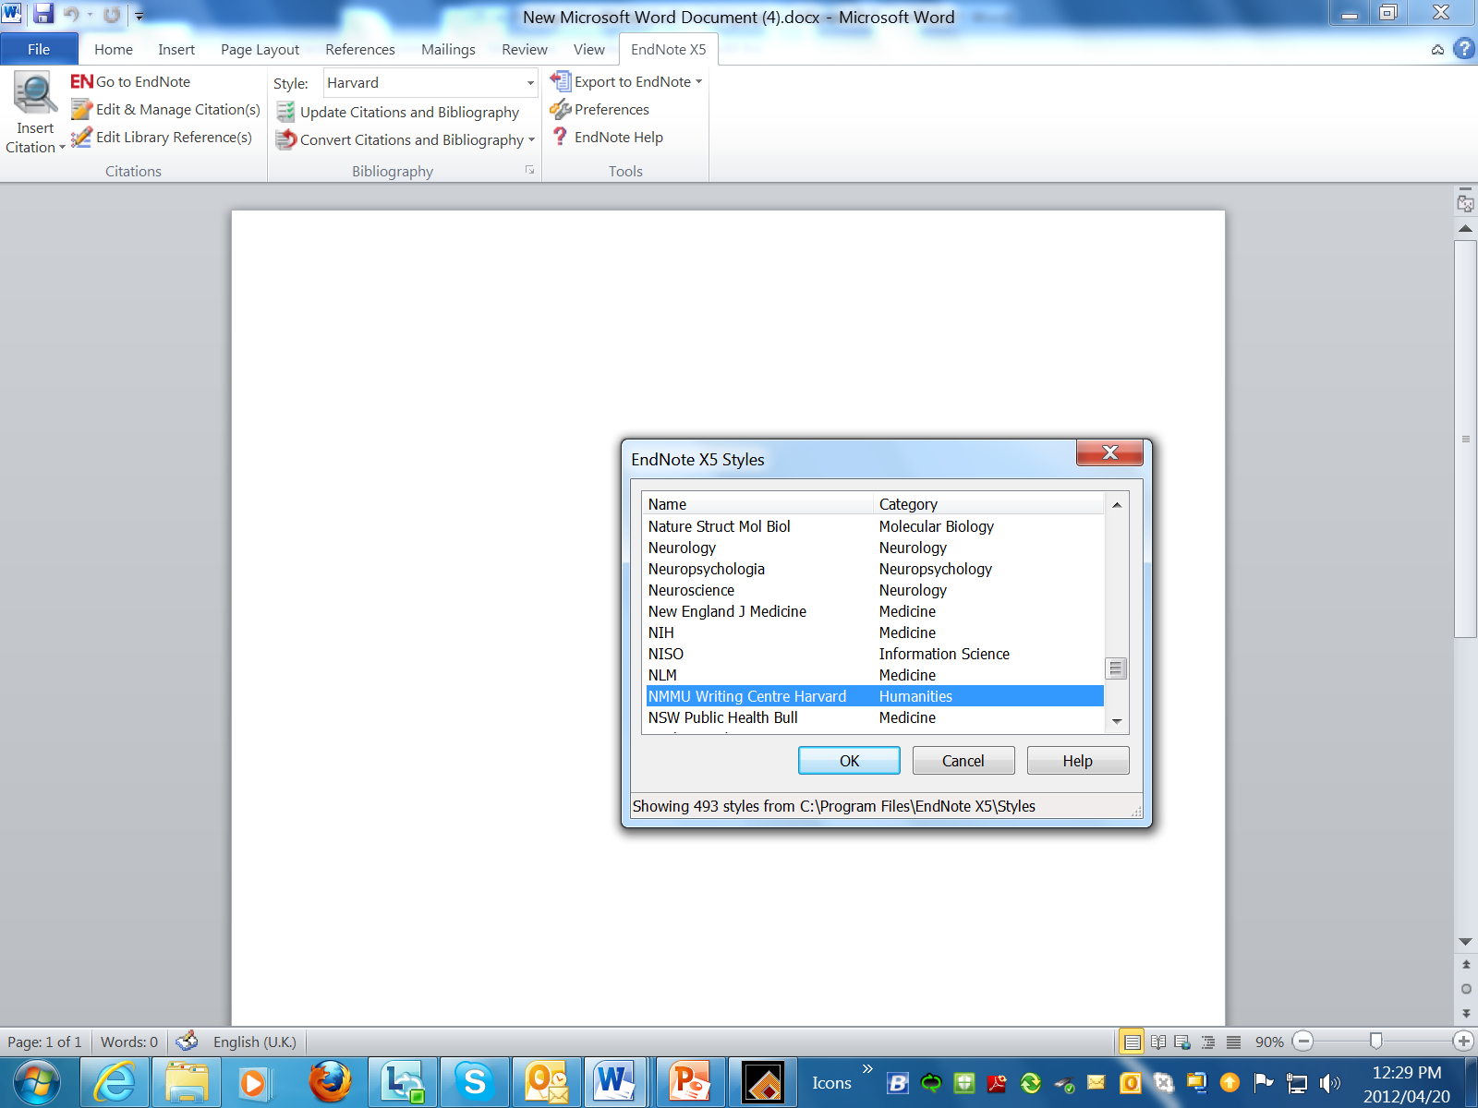
Choose the relevant Style from the list

Slide 6
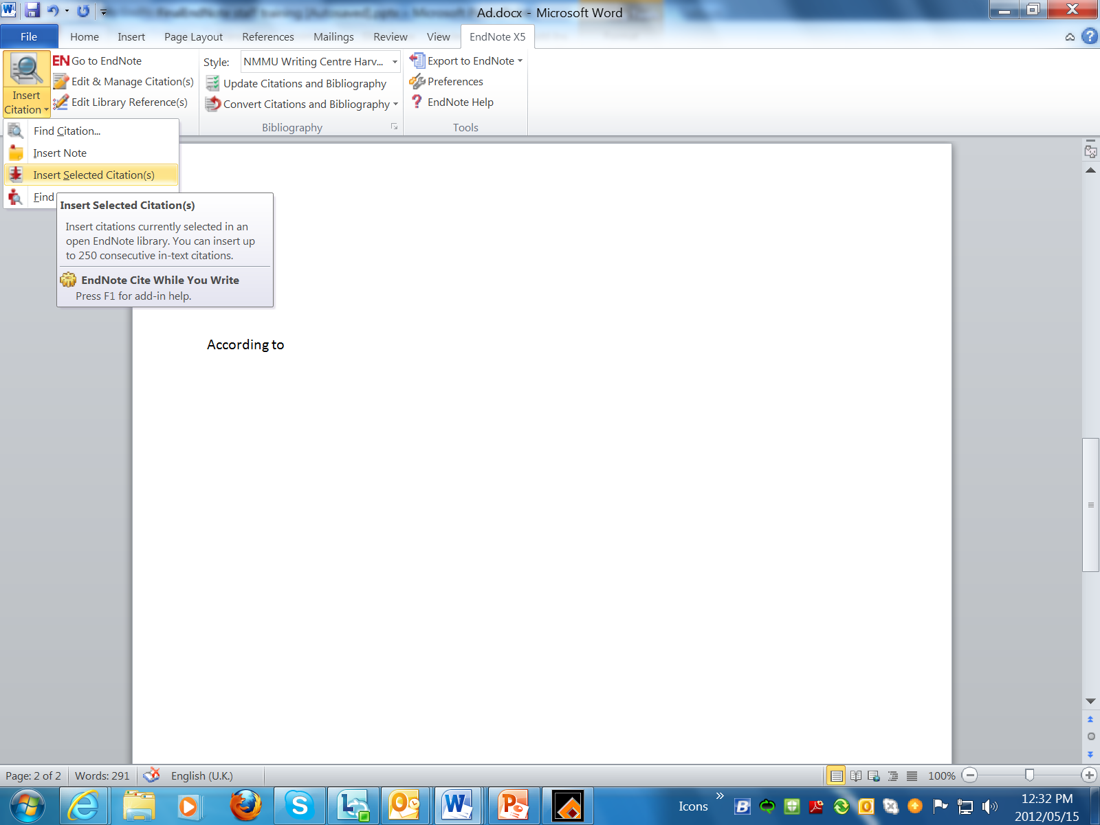
When you are writing and you want to include a reference, click here.

Slide 7
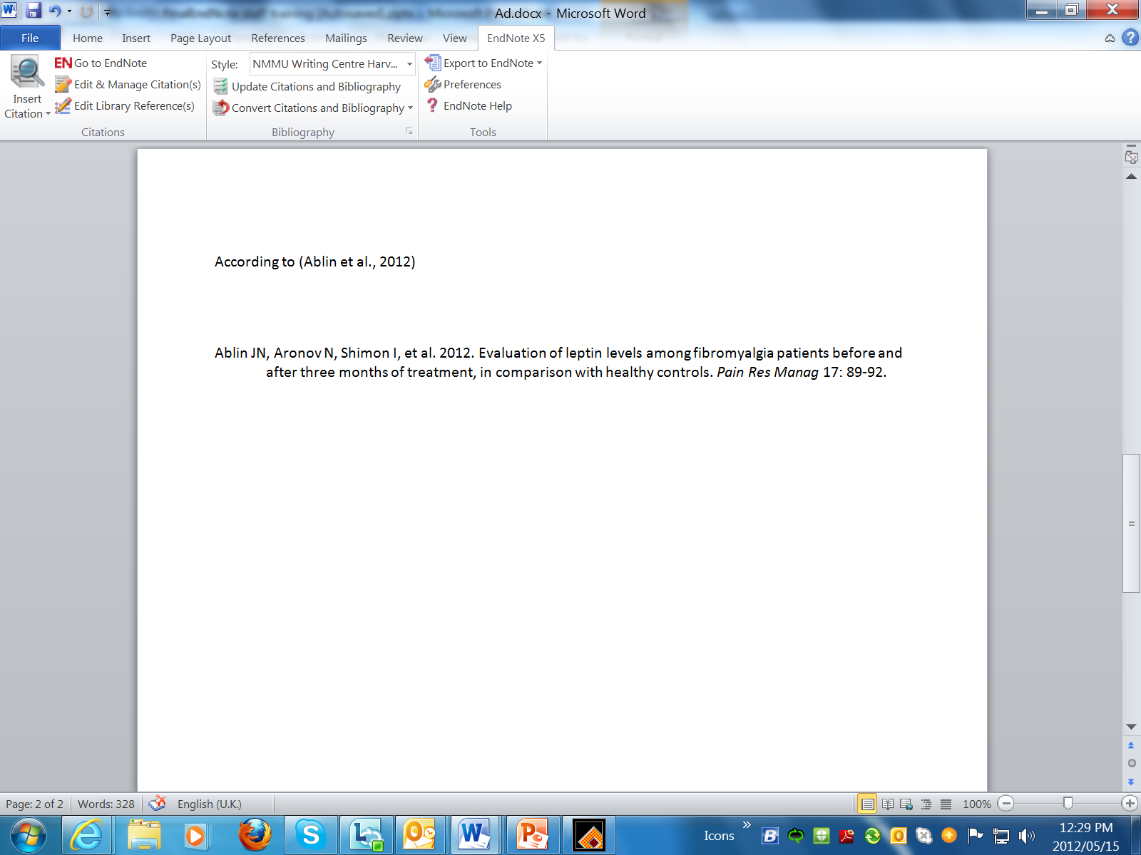
Reference added

Slide 8
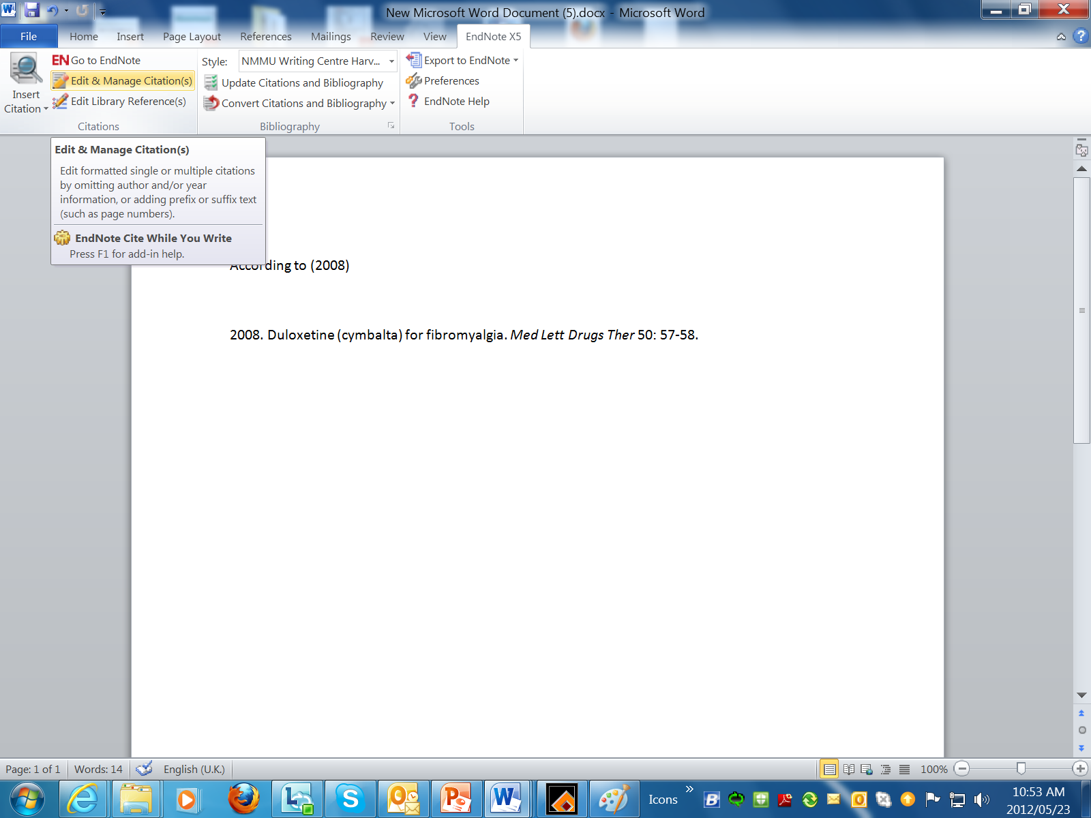
Editing a citation

Slide 9
