Slide 1
Getting started with ENDNOTE Compiled by Helene van der Sandt

Slide 2
TO EDIT AN EXISTING REFERENCE STYLE ON ENDNOTE

Slide 3
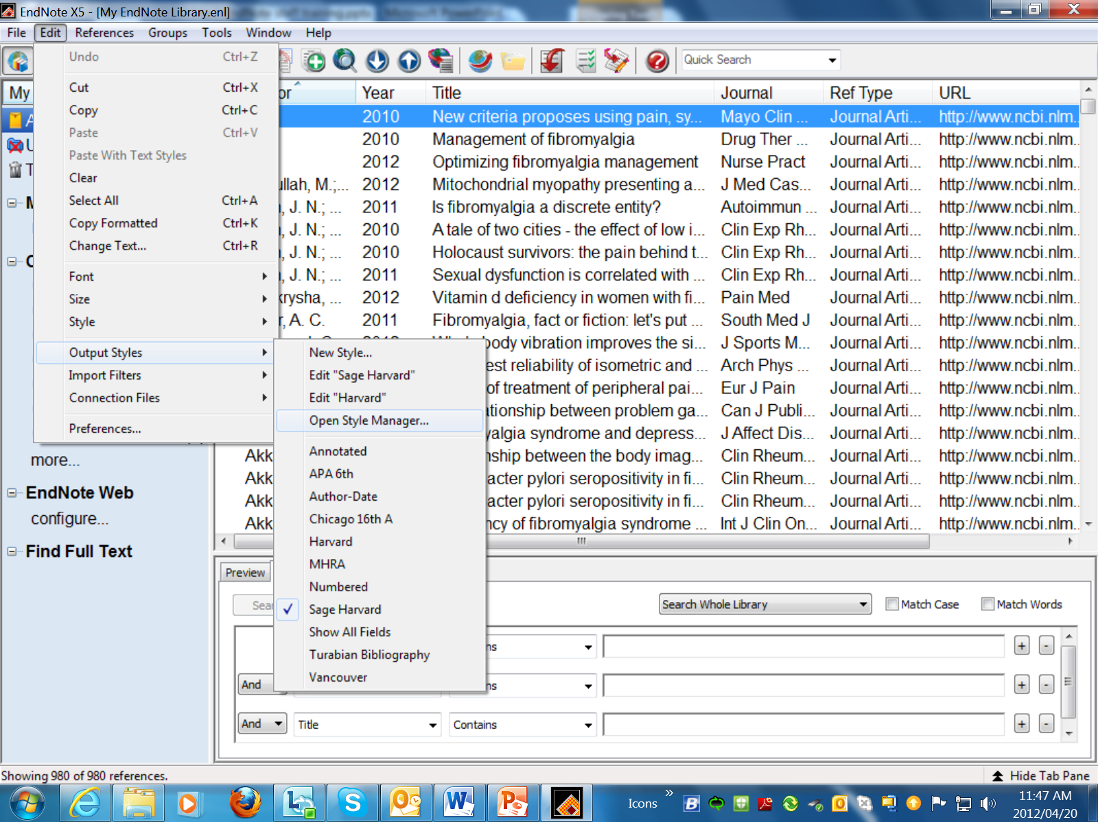
TO EDIT AN EXISTING REFERENCE STYLE ON ENDNOTE

Slide 4
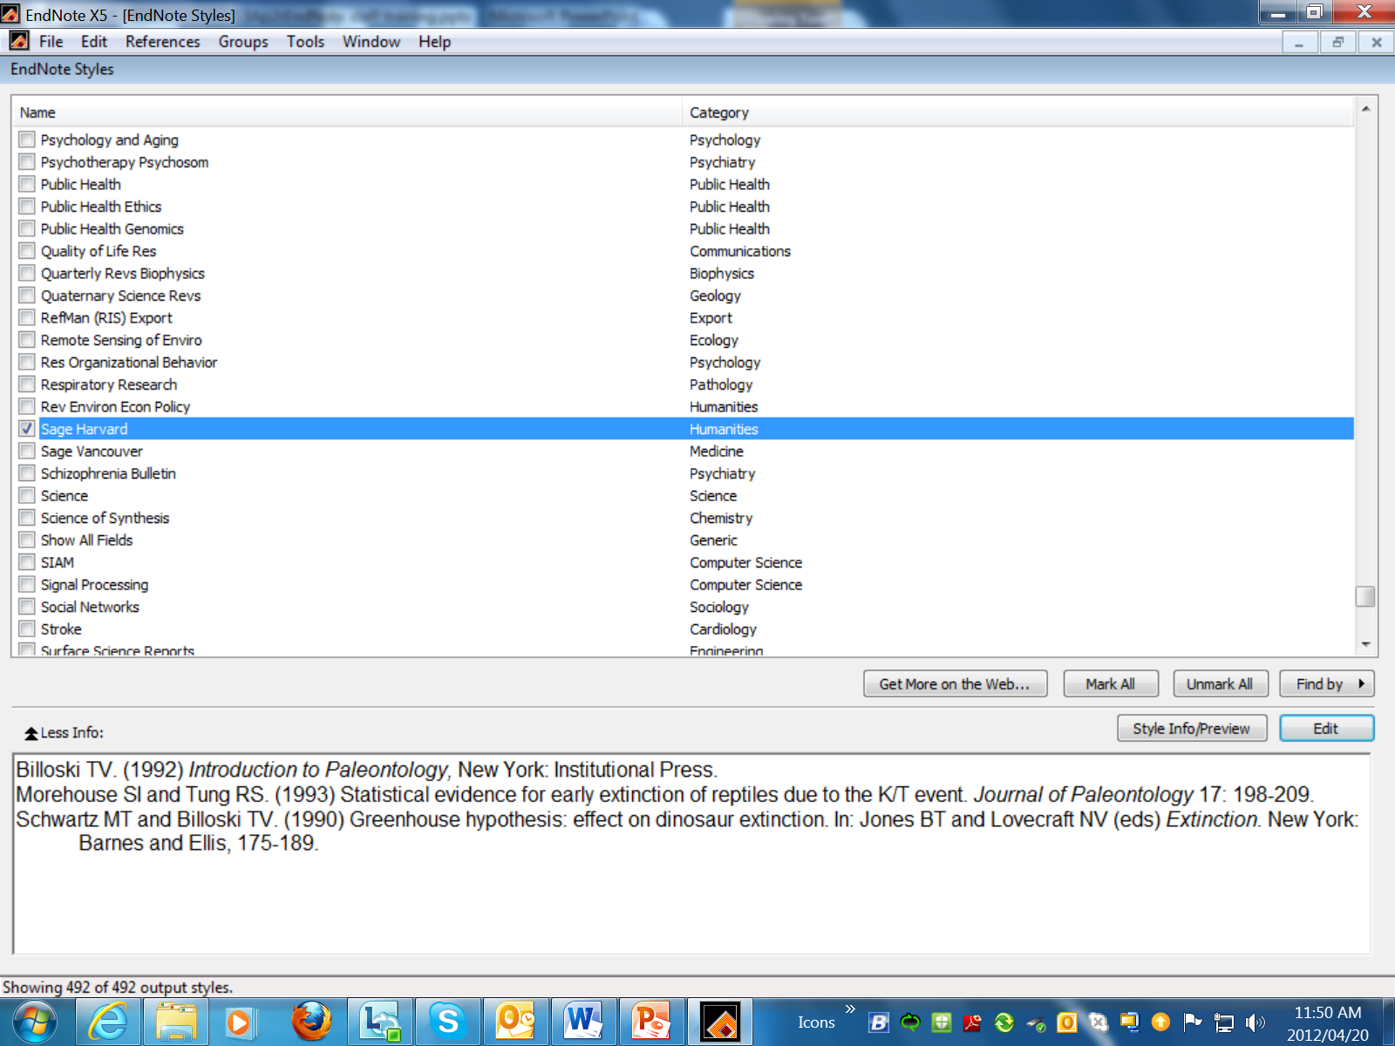
Scroll through the list. Select a similar Style and click Edit button

Slide 5
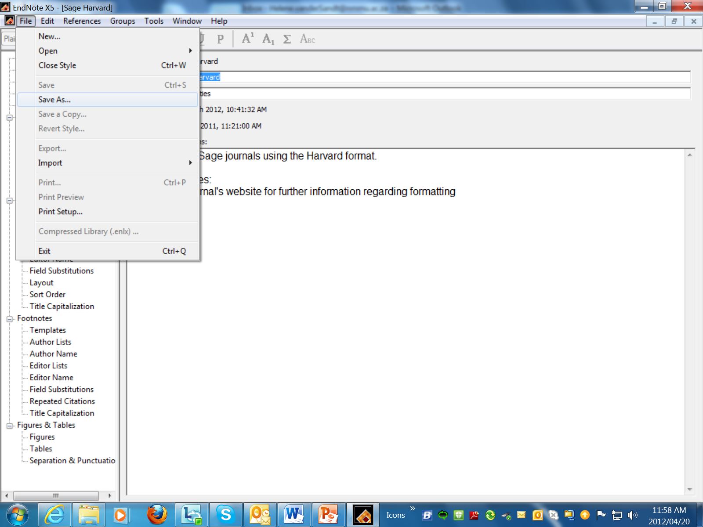
On the Style Window, click Edit and select “Save as”

Slide 6
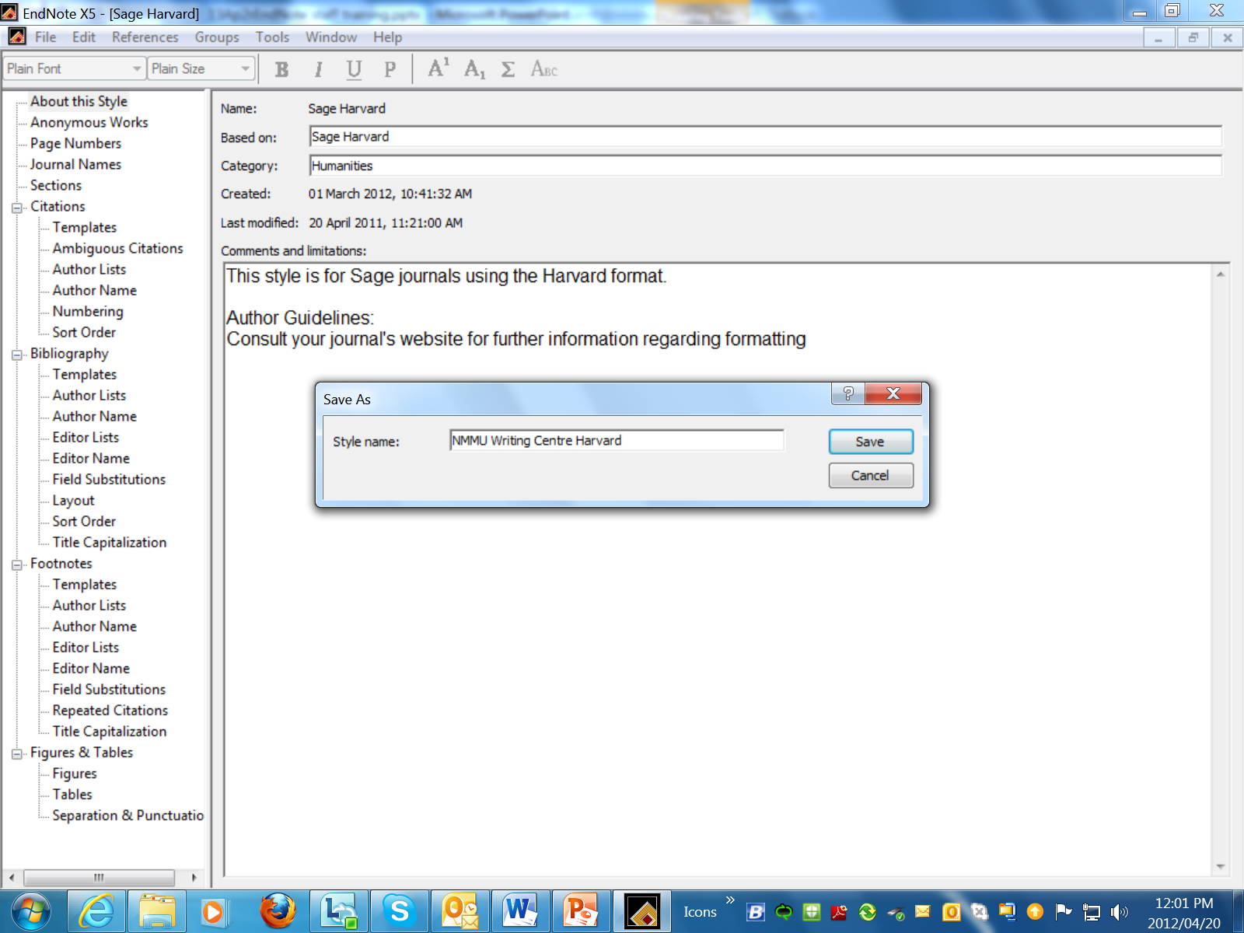
Save it under a new name.

Slide 7
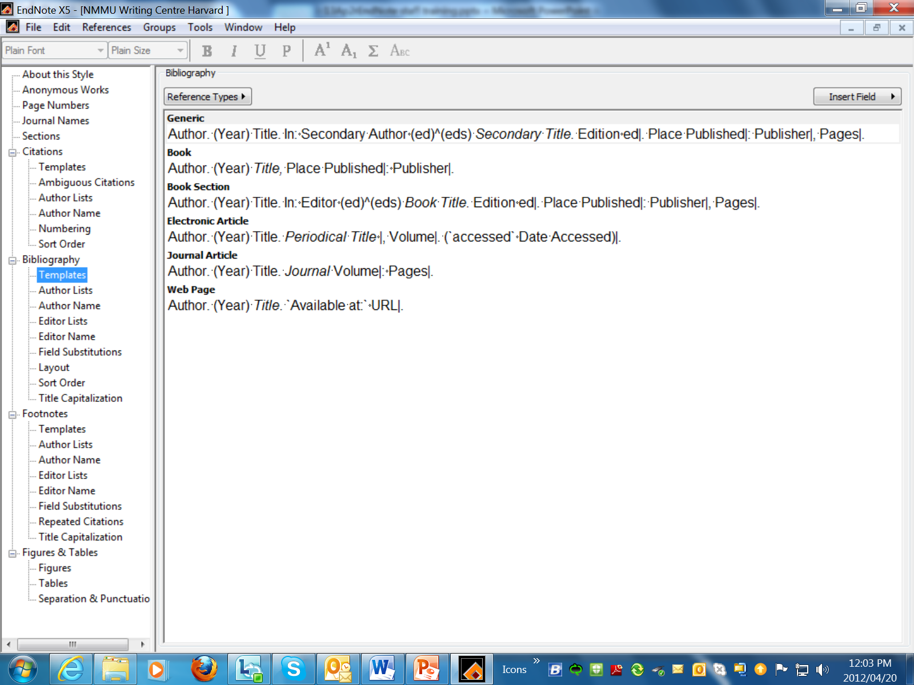

Slide 8
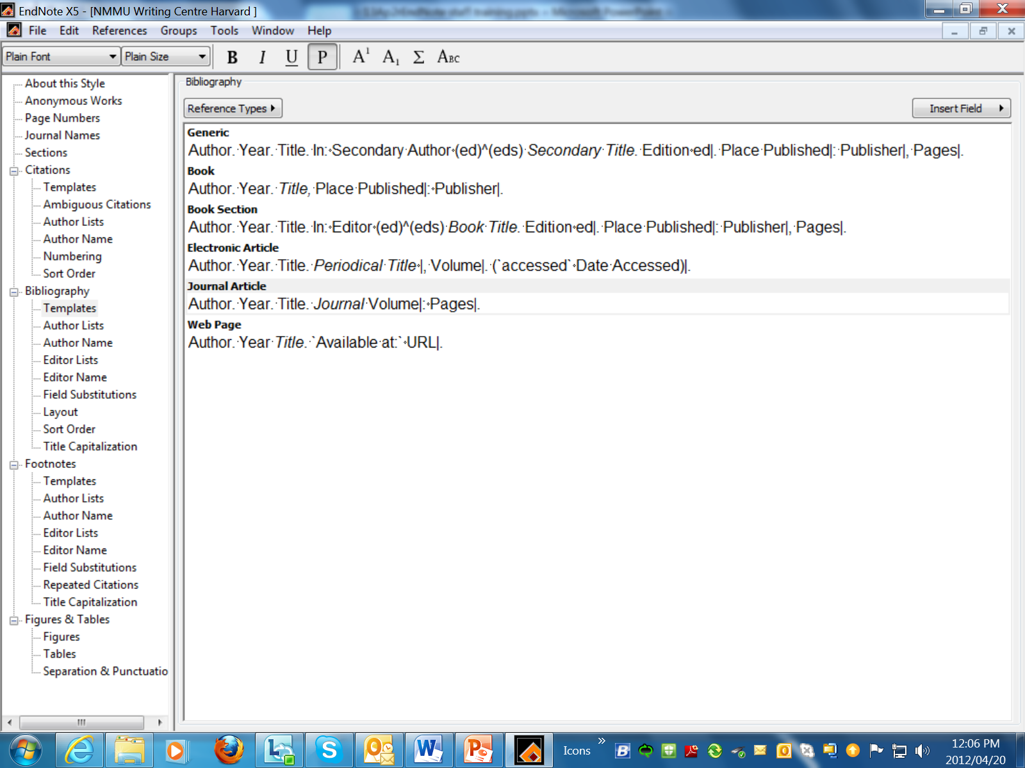
Once you done editing, save your work and close the screen. It will now be added to the Style Menus.

Slide 9
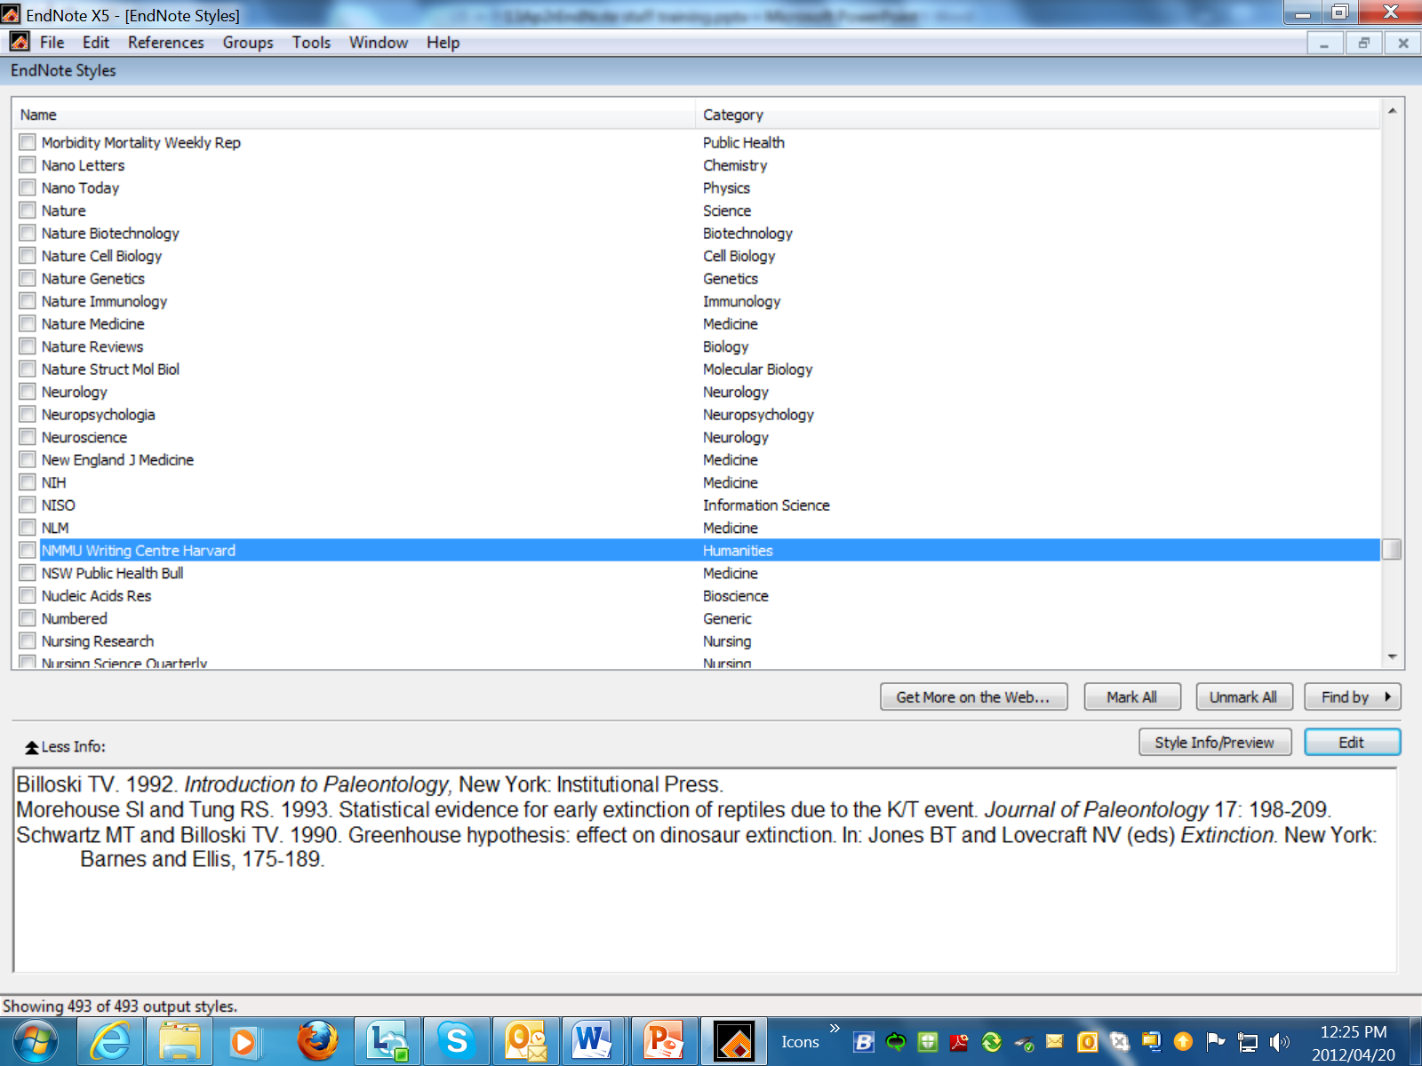

Slide 10
SEARCH FOR FULL TEXT OF ENDNOTE CITATIONS

Slide 11
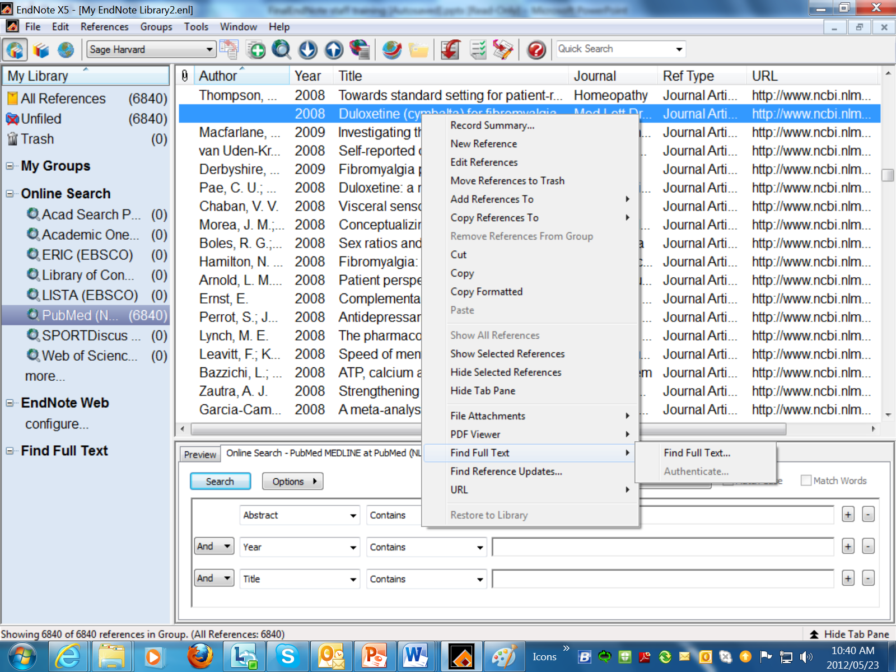

Slide 12
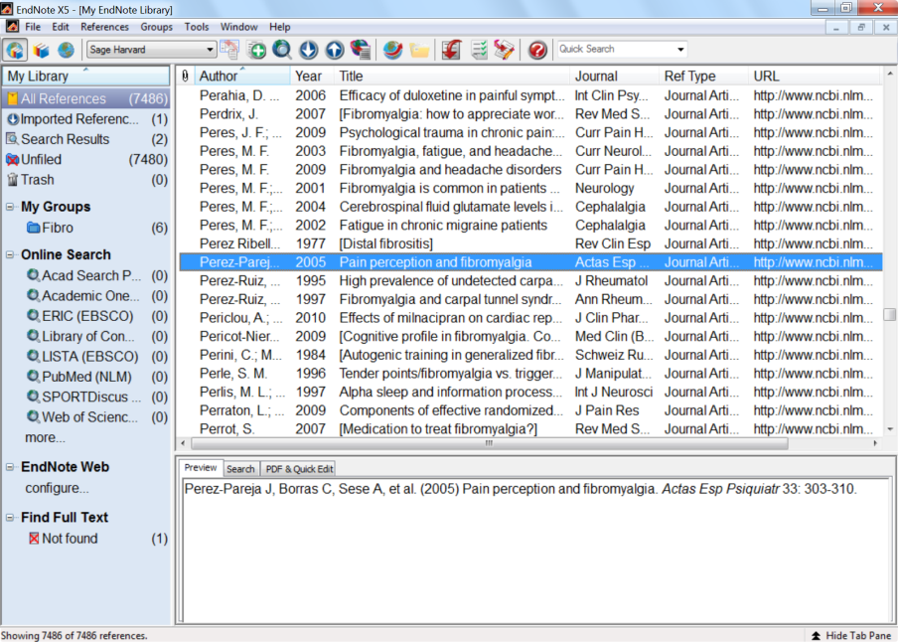
By default EndNote will search public sources that do not require authentication for access

