Slide 1
ENDNOTE
Installation Guide

Slide 2
EENDNOTE ON LIBRARY PAGE (www.nmmu.ac.za/library)
Scroll down to see download instructions

Slide 3
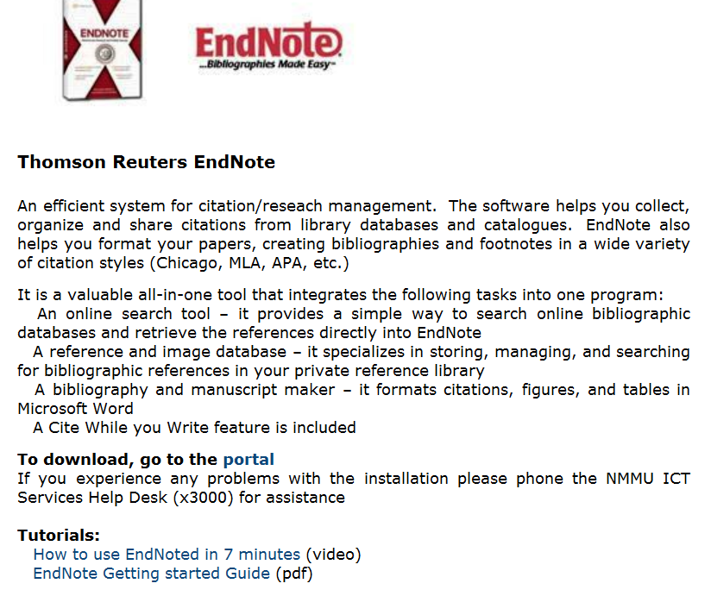
ENDNOTE ON LIBRARY PAGE (www.nmmu.ac.za/library): Download Instructions
Click on Portal

Slide 4
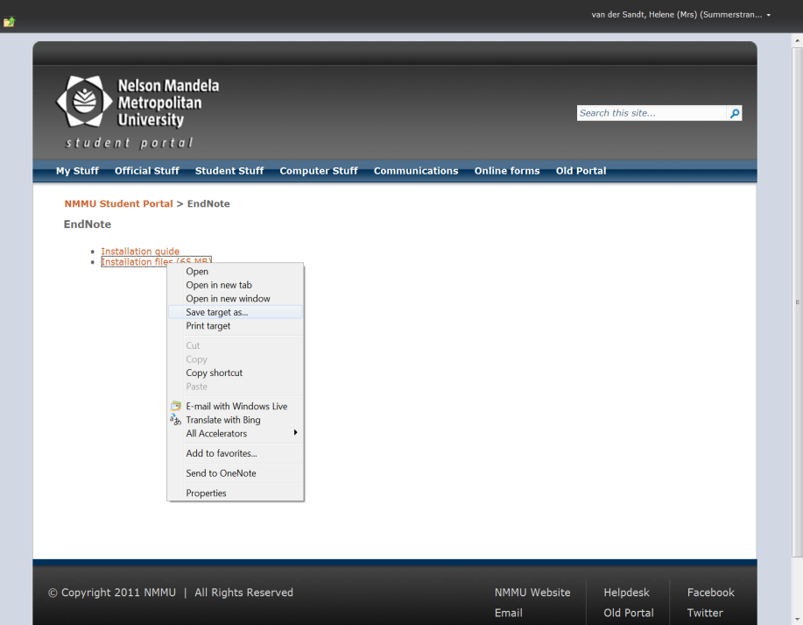
Right click on “Installation files” and select “Save target as”

Slide 5
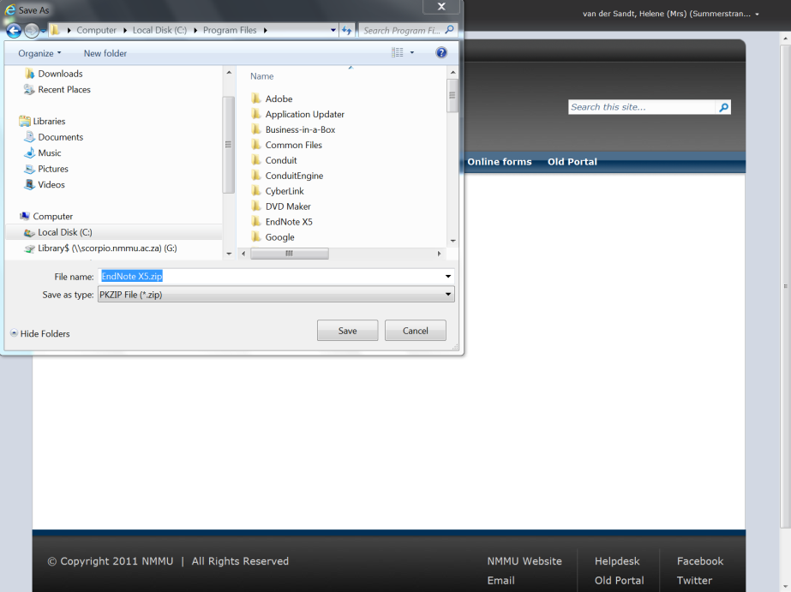
Save to
to the following location:
Local Disk (C drive) \Program Files

Slide 7
Double click the file in the folder called “ENX5Inst.msi” to begin the install.
In cases where unzipping is not automatically, you have to use a unzip programme to unzip this file.
If you have problems with unzipping and you have a trial version of an unzip programme you first have to uninstall the trial version of the unzip programme.

Slide 8
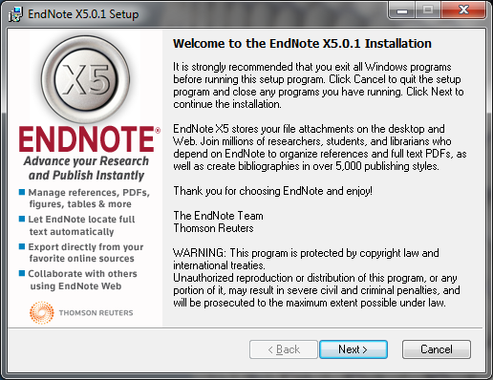
The install wizard will start, follow these steps to complete the install

Slide 9
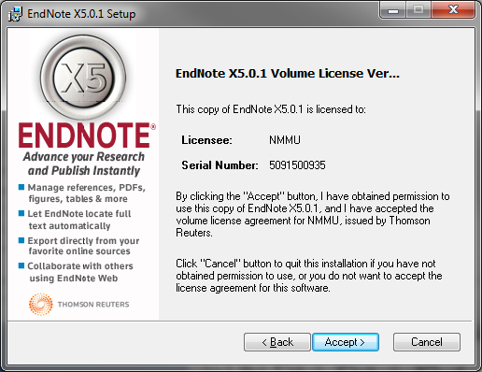

Slide 10
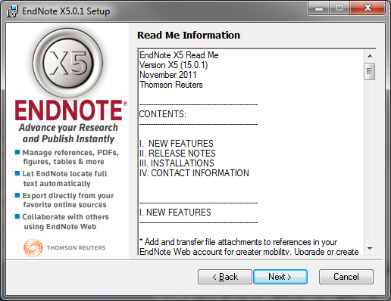

Slide 11
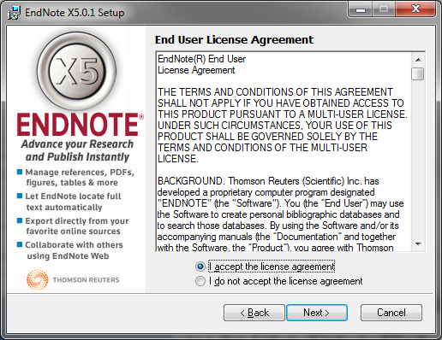
Click “I accept the license agreement”
Click Next

Slide 12
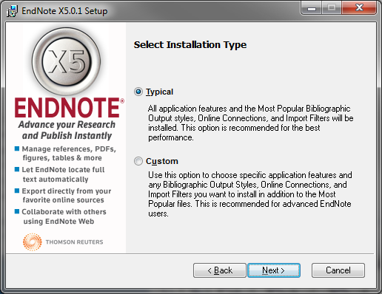

Slide 13
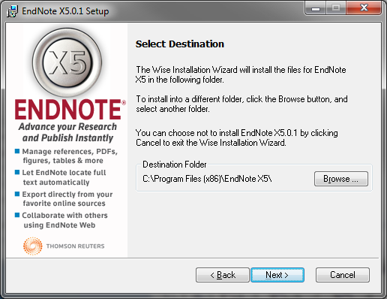
You can change the install location here or accept the default
Click Next to continue once done

Slide 14
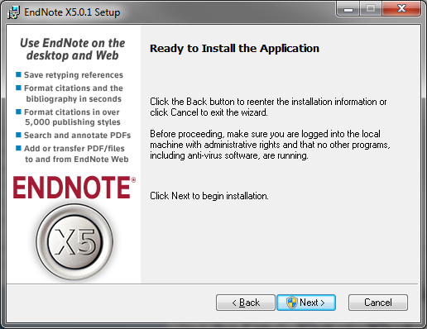
Click Next
a. Windows UAC may prompt you to authorize the installation.
b. Click yes to accept
c. The install will now begin

Slide 15
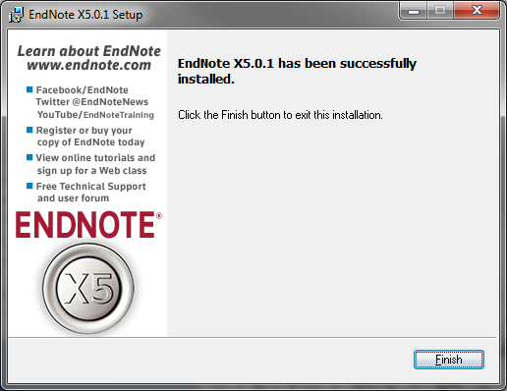
Once the install is complete, Click Finish.

Slide 16
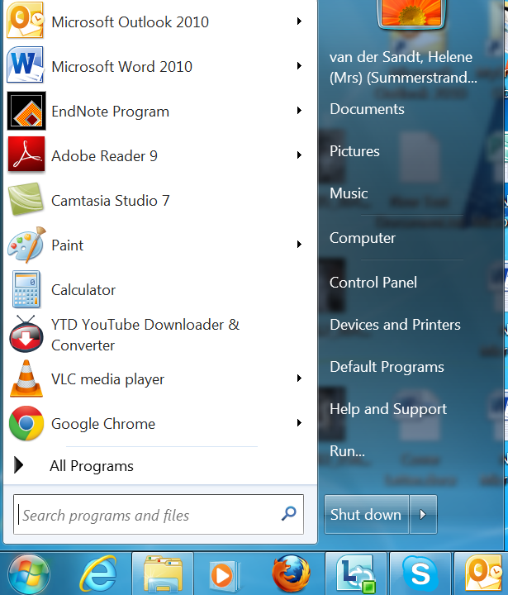
Find EndNote X5 on your computer

Slide 17
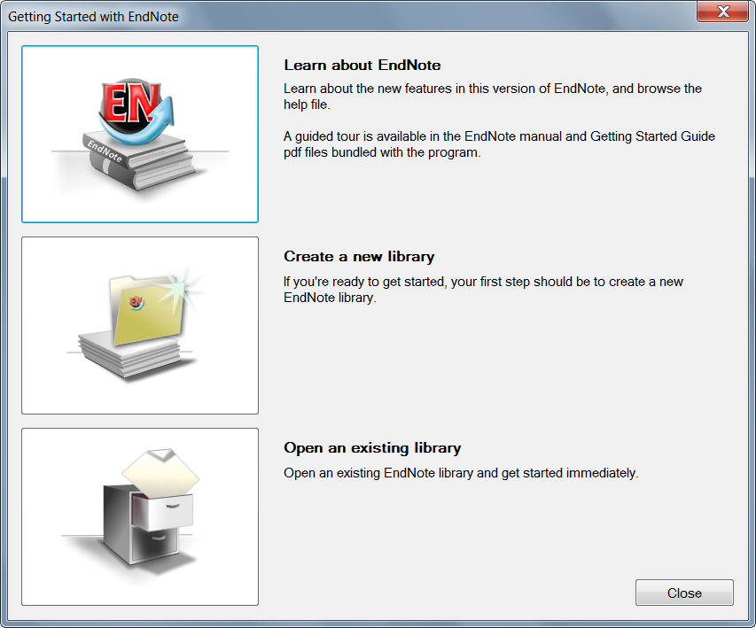
Create a New EndNote Library
The first time you access EndNote you have to:
Click here to create a new library

Slide 18
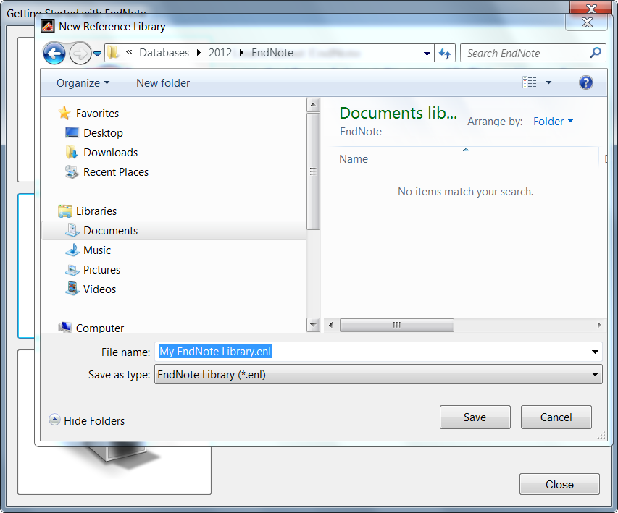
Save EndNote Library on your computer under “My documents”

Slide 19
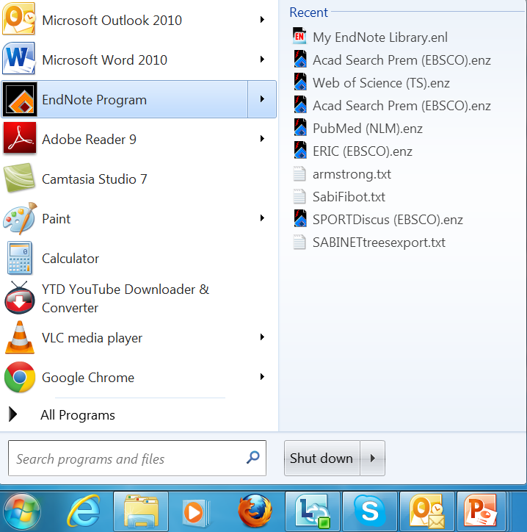
Access to My EndNote Library

Slide 20
You are now ready to use EndNote X5

