Slide 1
Export from SA e-publications and sabinet to endnote

Slide 2
YOU FIRST HAVE TO DOWNLOAD the SABINET FILTER

Slide 3
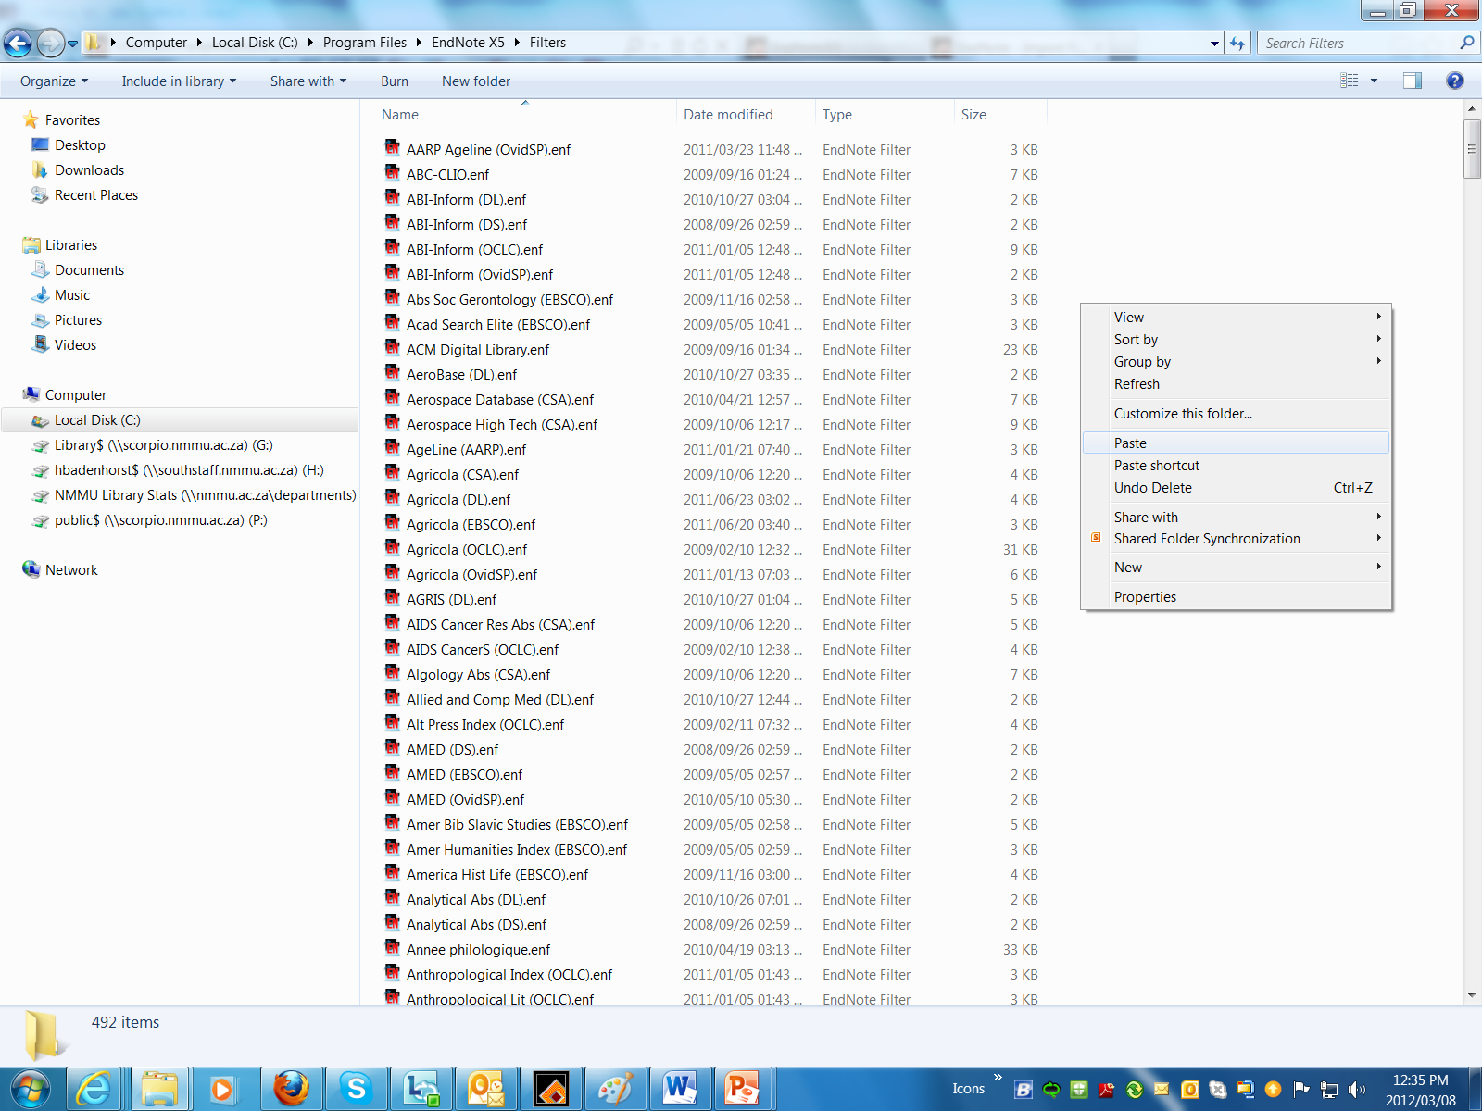
Paste the file I sent you by email to the appropriate folder in your EndNote program directory (usually located in Windows—C:\Program Files\EndNote\Filters or Mac OS X— Harddrive:Applications:EndNote:Filters).

Slide 4
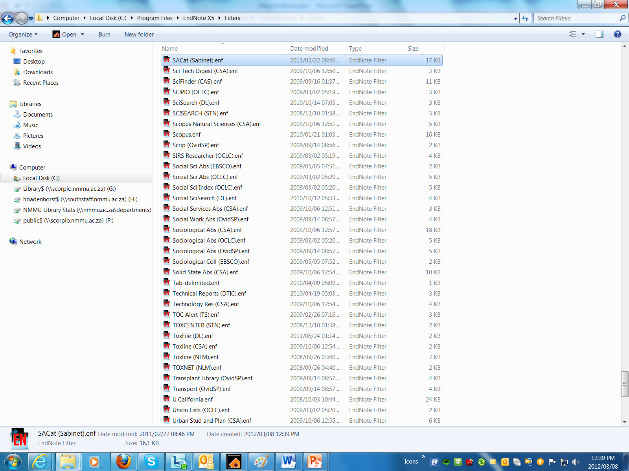
Filter for Sabinet added

Slide 5
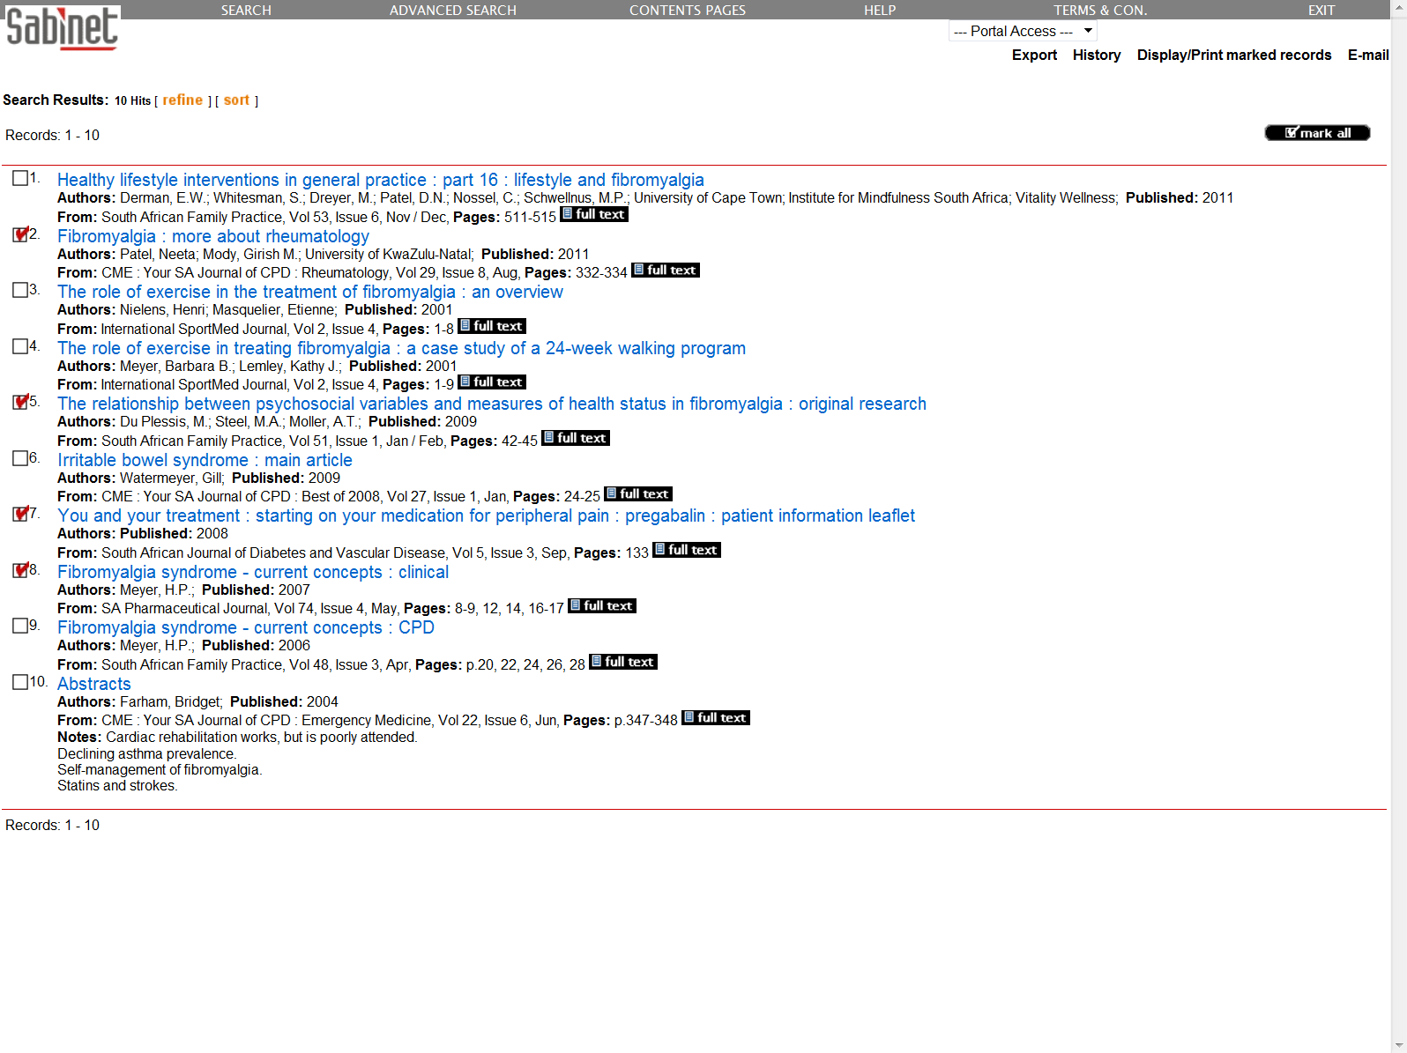

Slide 6
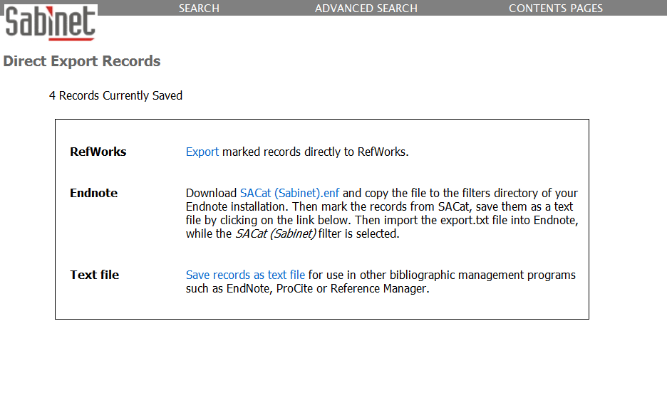
Click on: Save records as text file

Slide 7
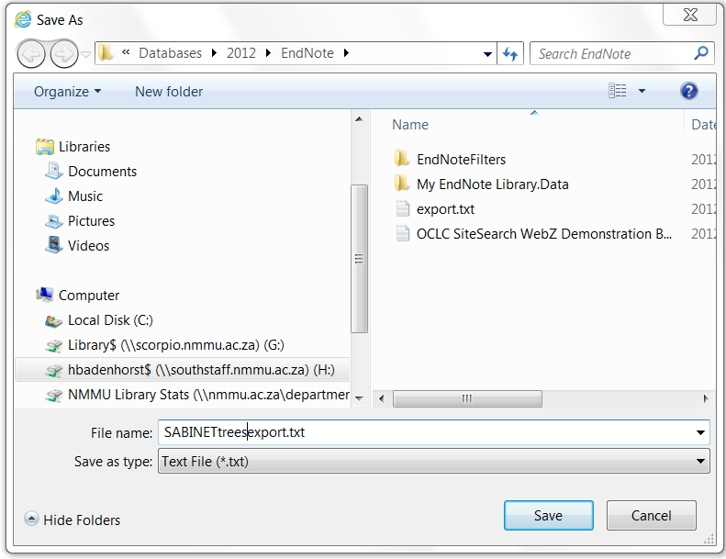
Choose where to save this file to and give it a name

Slide 8
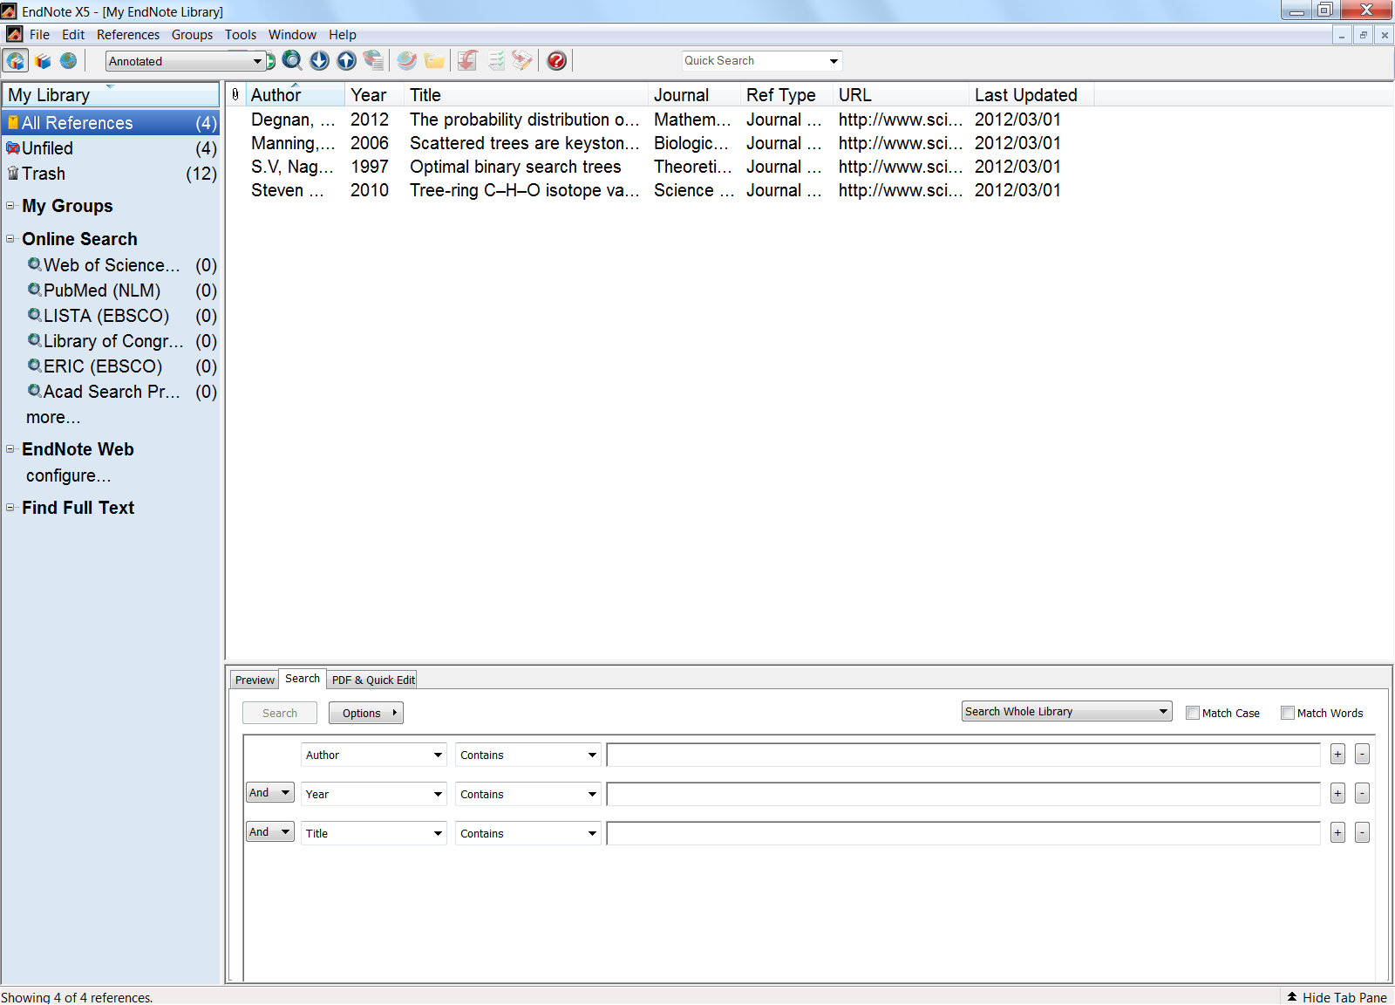
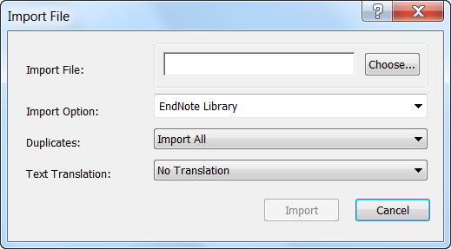
Go to EndNote and select the Import button
Click on choose

Slide 9
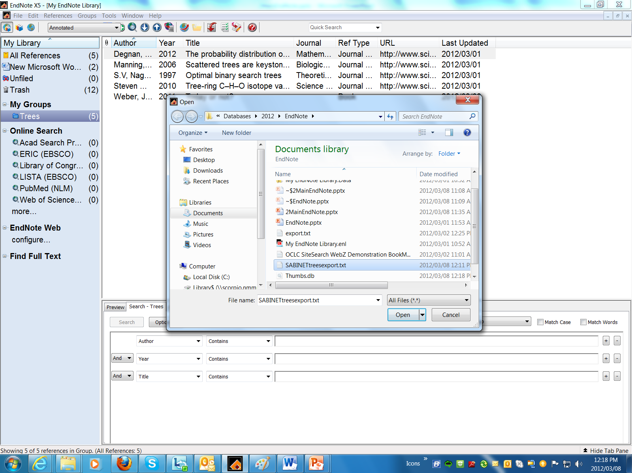
Select relevant file where you saved your Sabinet references

Slide 10
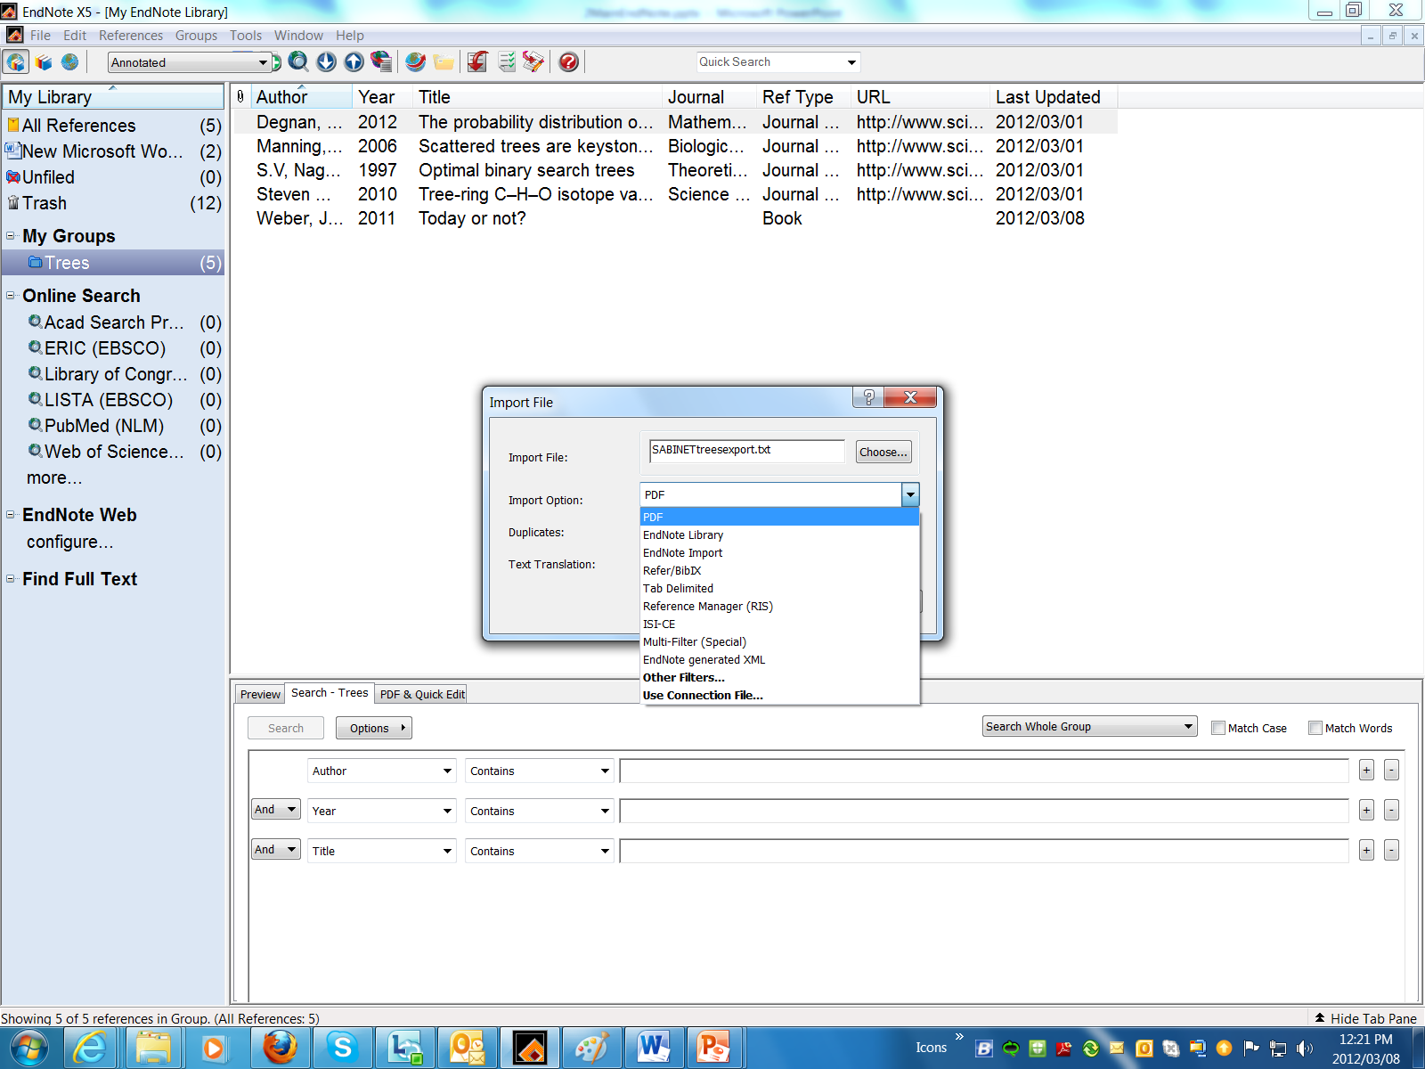

Slide 11
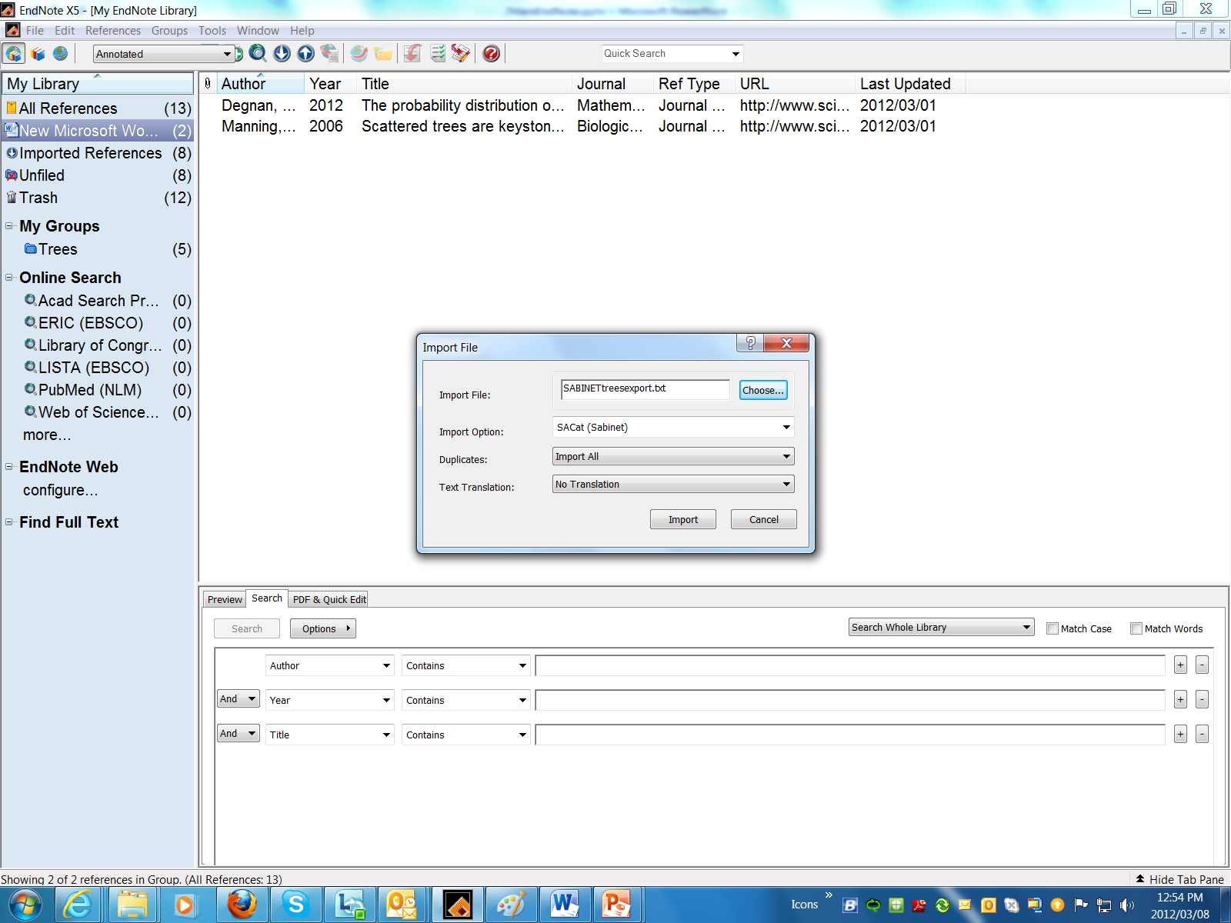
Select: SACat (Sabinet)

Slide 12
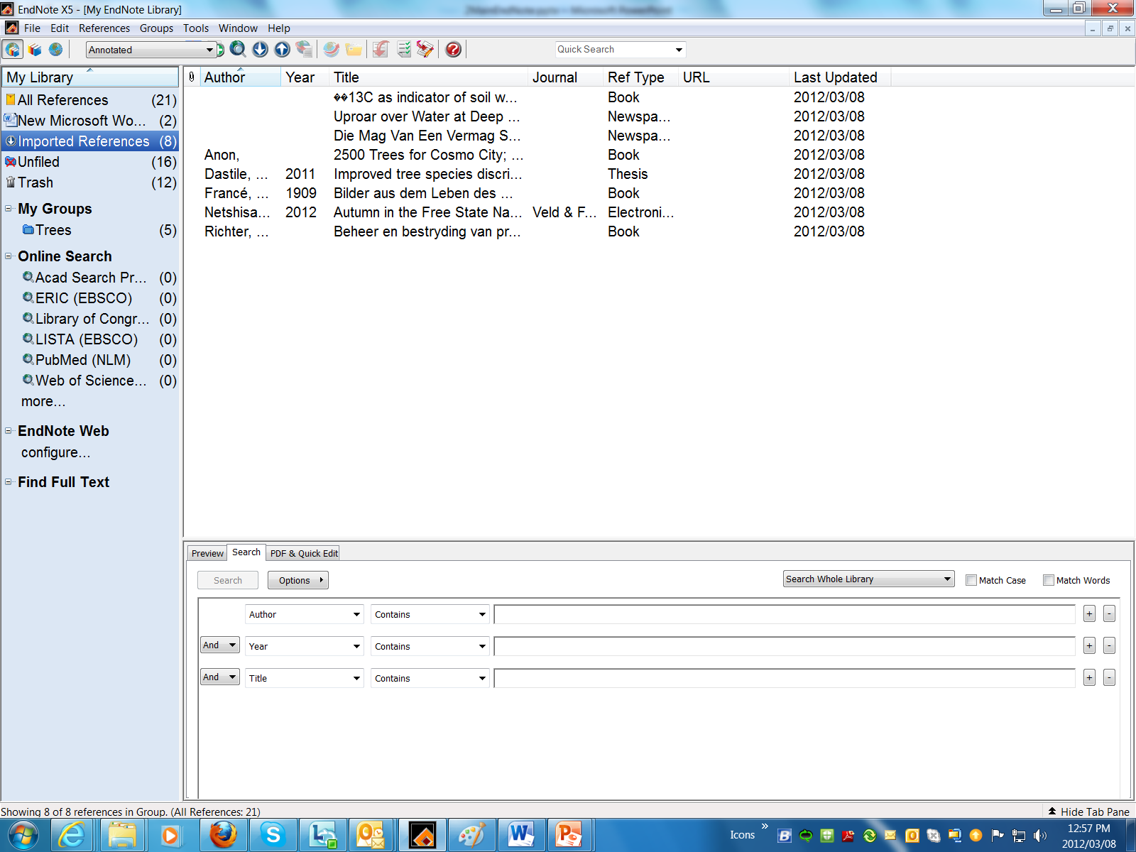
Sabinet references imported

