Slide 1
Getting started with ENDNOTE Compiled by Helene van der Sandt

Slide 2
EDITING AND ADDING FILES TO REFERENCES

Slide 3
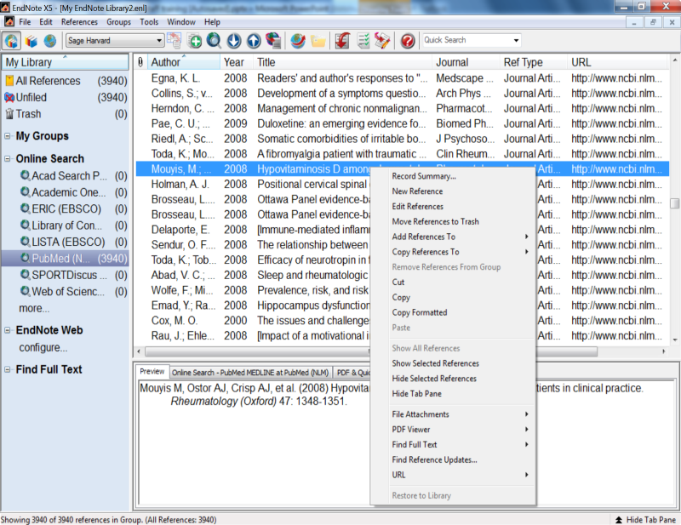
Editing a reference

Slide 4
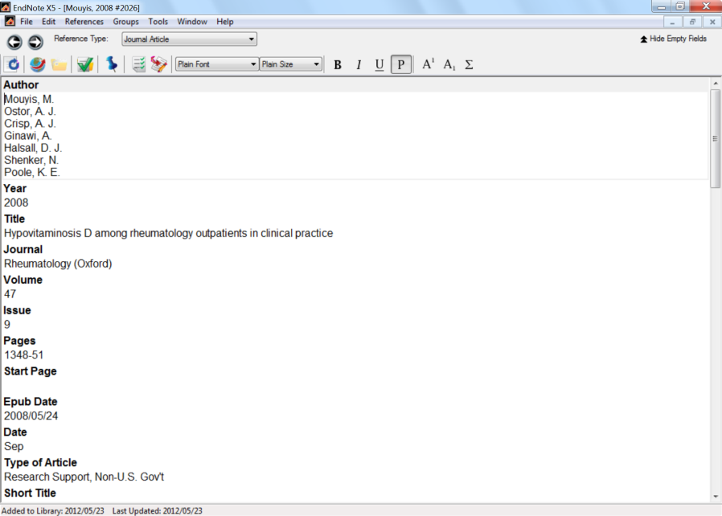
Editing references
Edit the citation.
Save and close citation

Slide 5
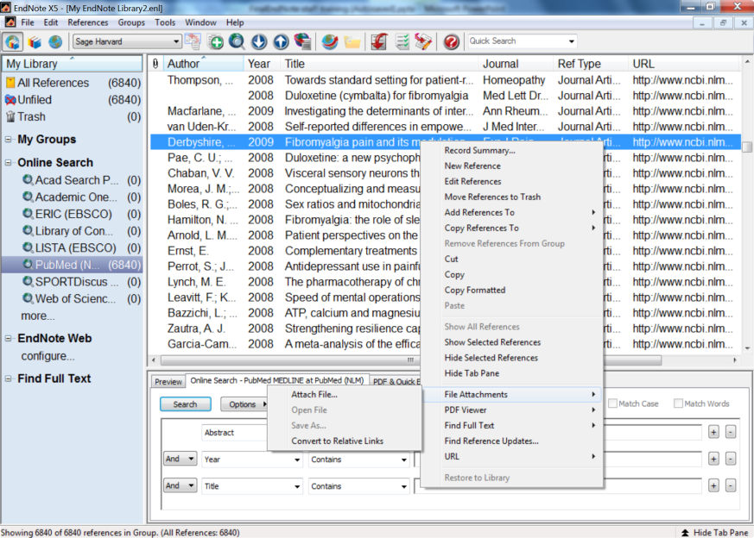
Adding files/attachments to citations
Highlight relevant citation. Right click on citation.

Slide 6
CREATING GROUPS

Slide 7
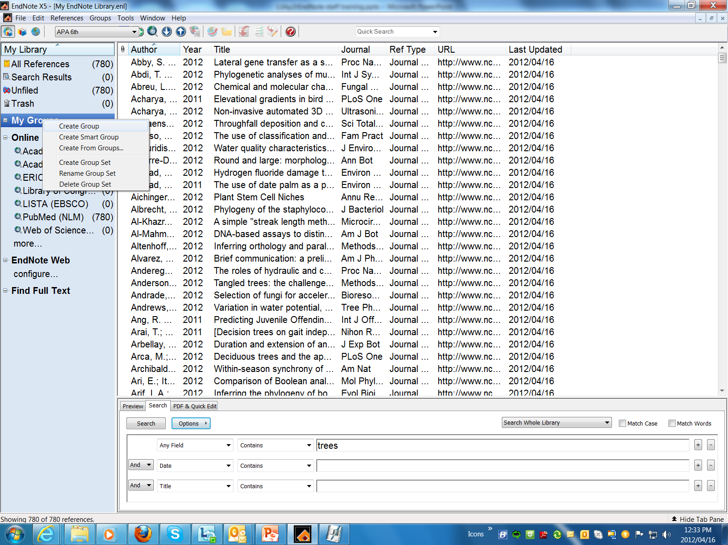
Right click on”My Groups”

Slide 8
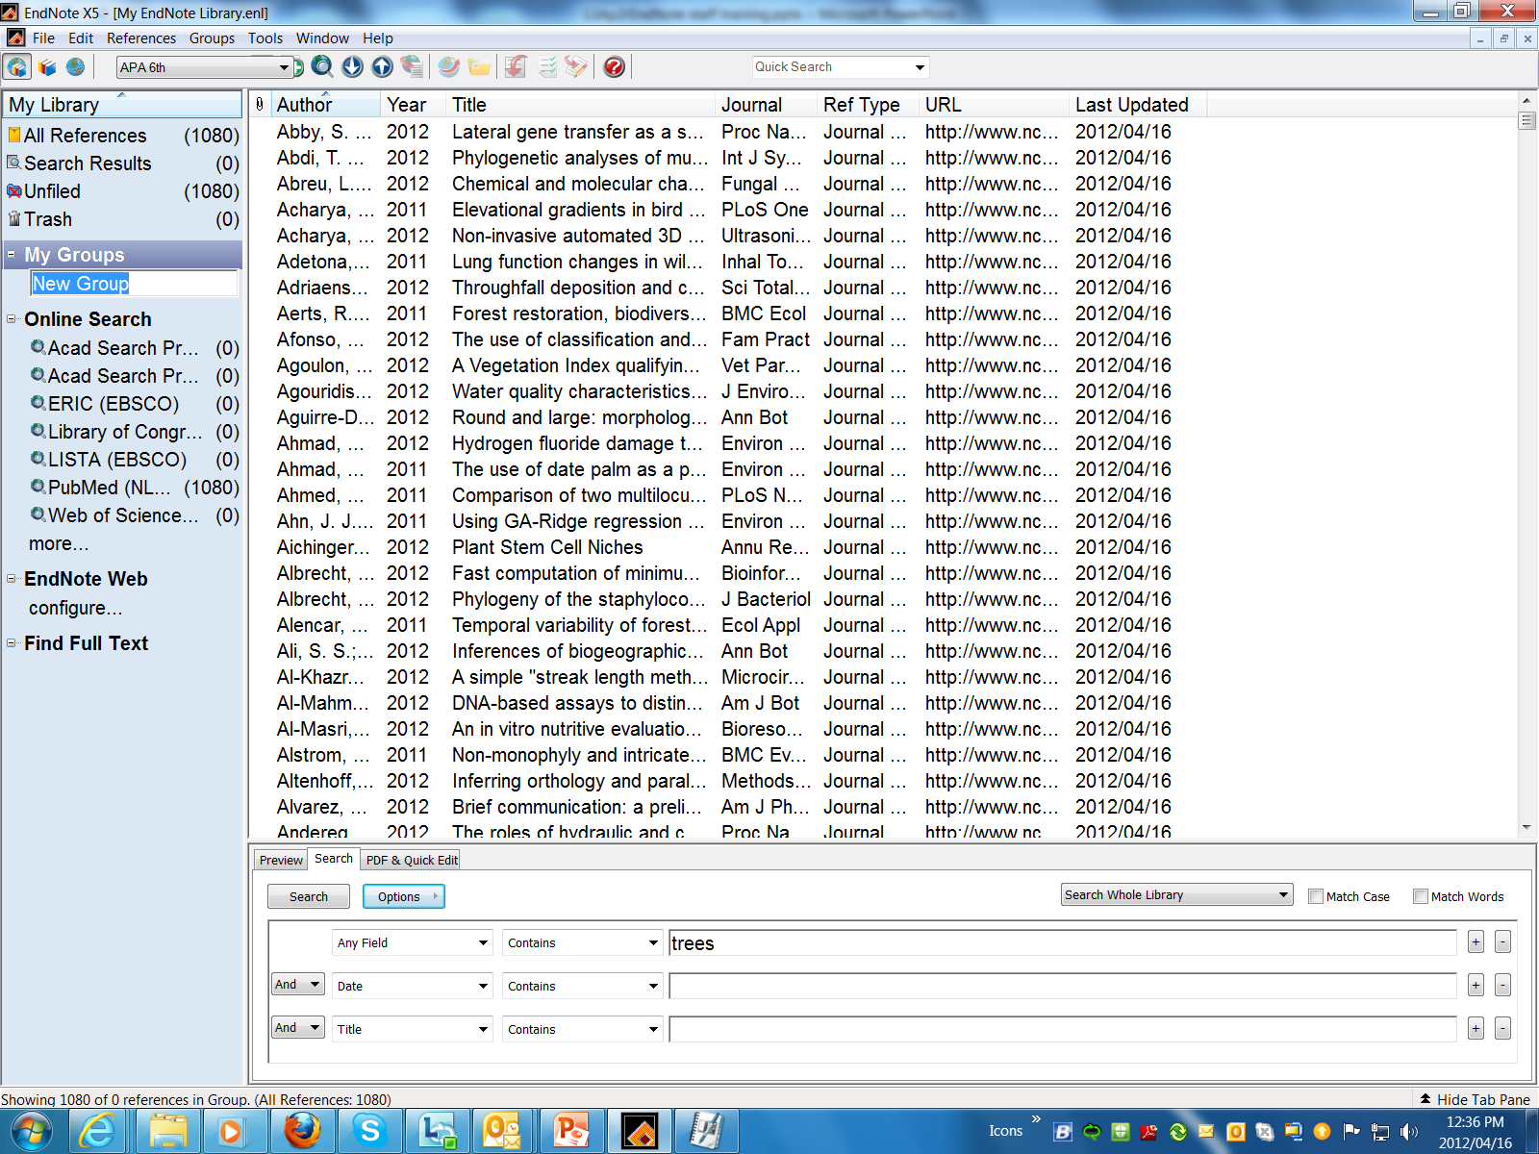
Type in the name of your Group

Slide 9
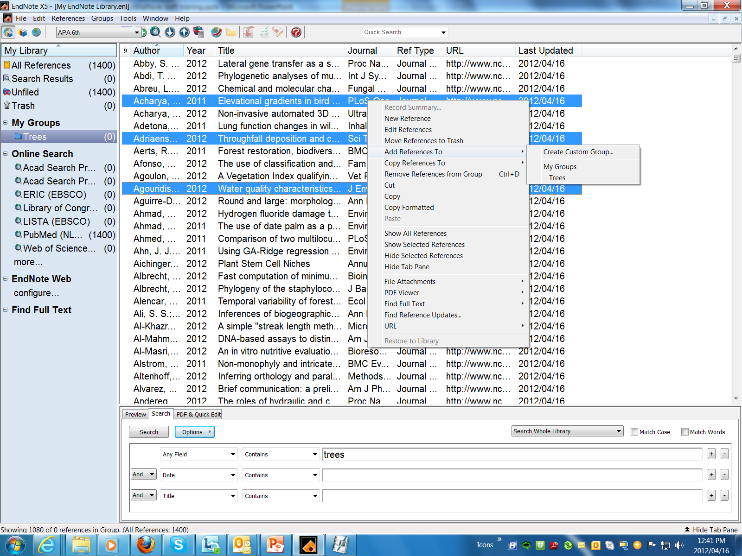
To add references to a group
Keep Ctrl button pressed in to be able to select more than one reference
Right click and select the following
or
Simply drag and drop to relevant group

Slide 10
REFERENCE STYLES

Slide 11
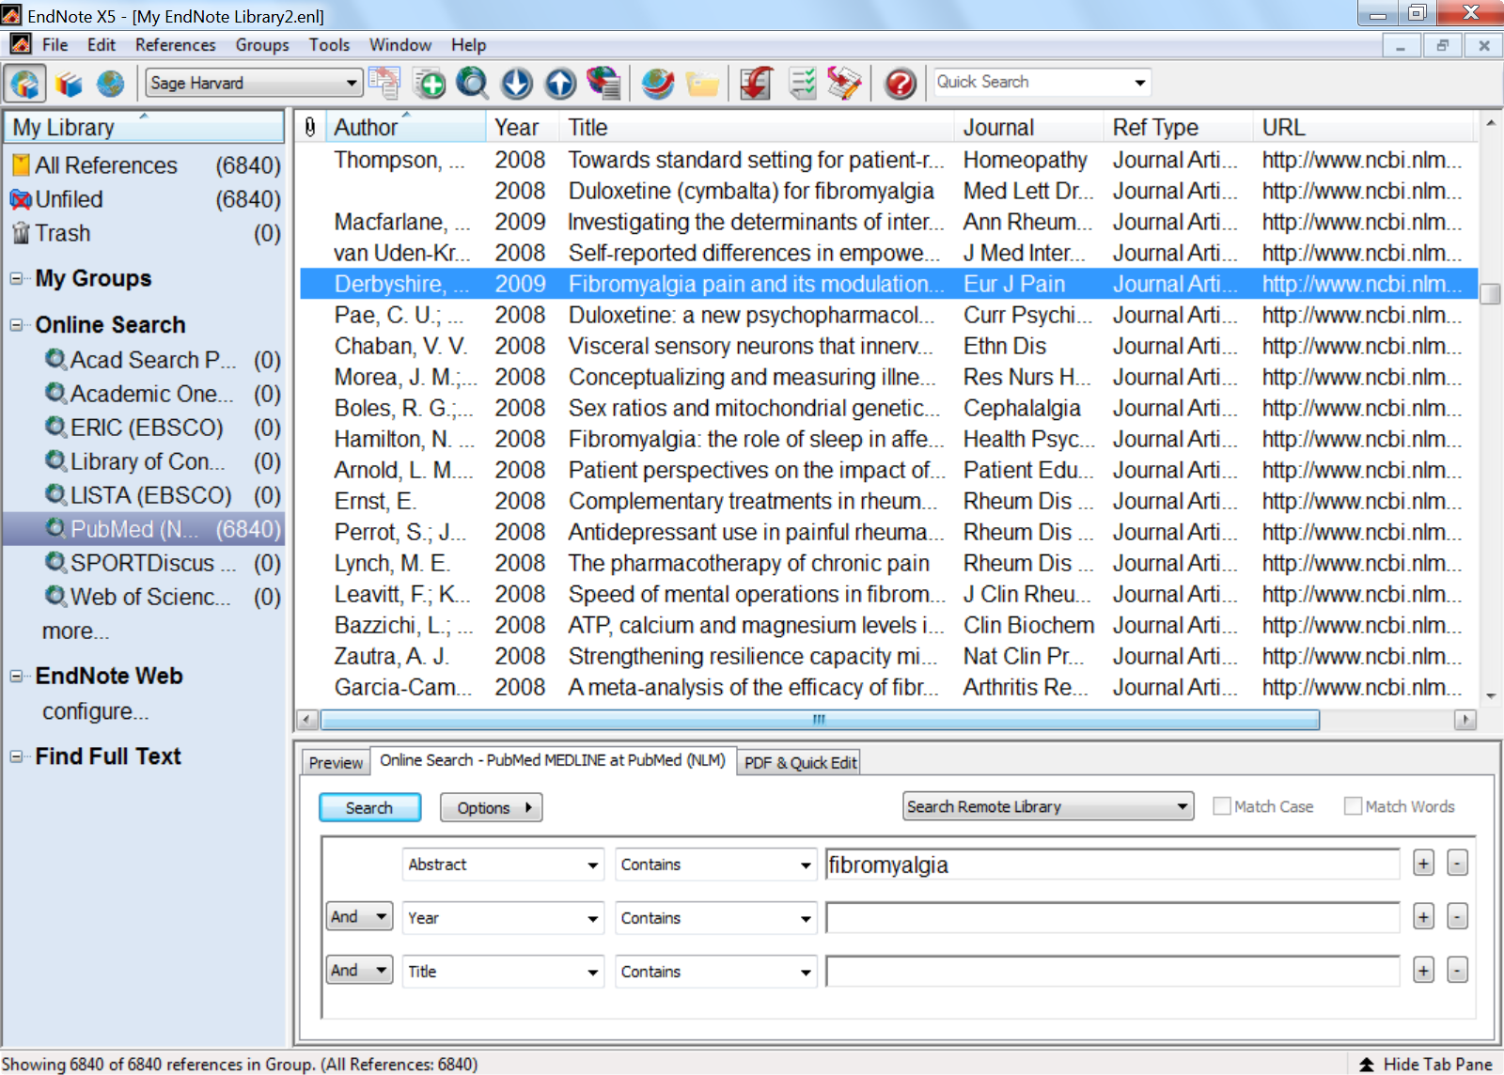
Change Reference Style
Click on the down arrow

Slide 12
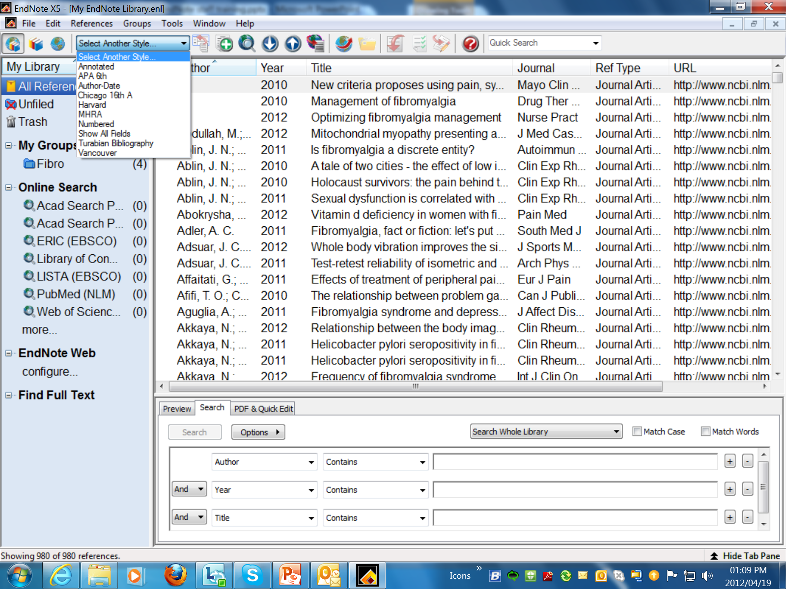
To change Ref Style

Slide 13
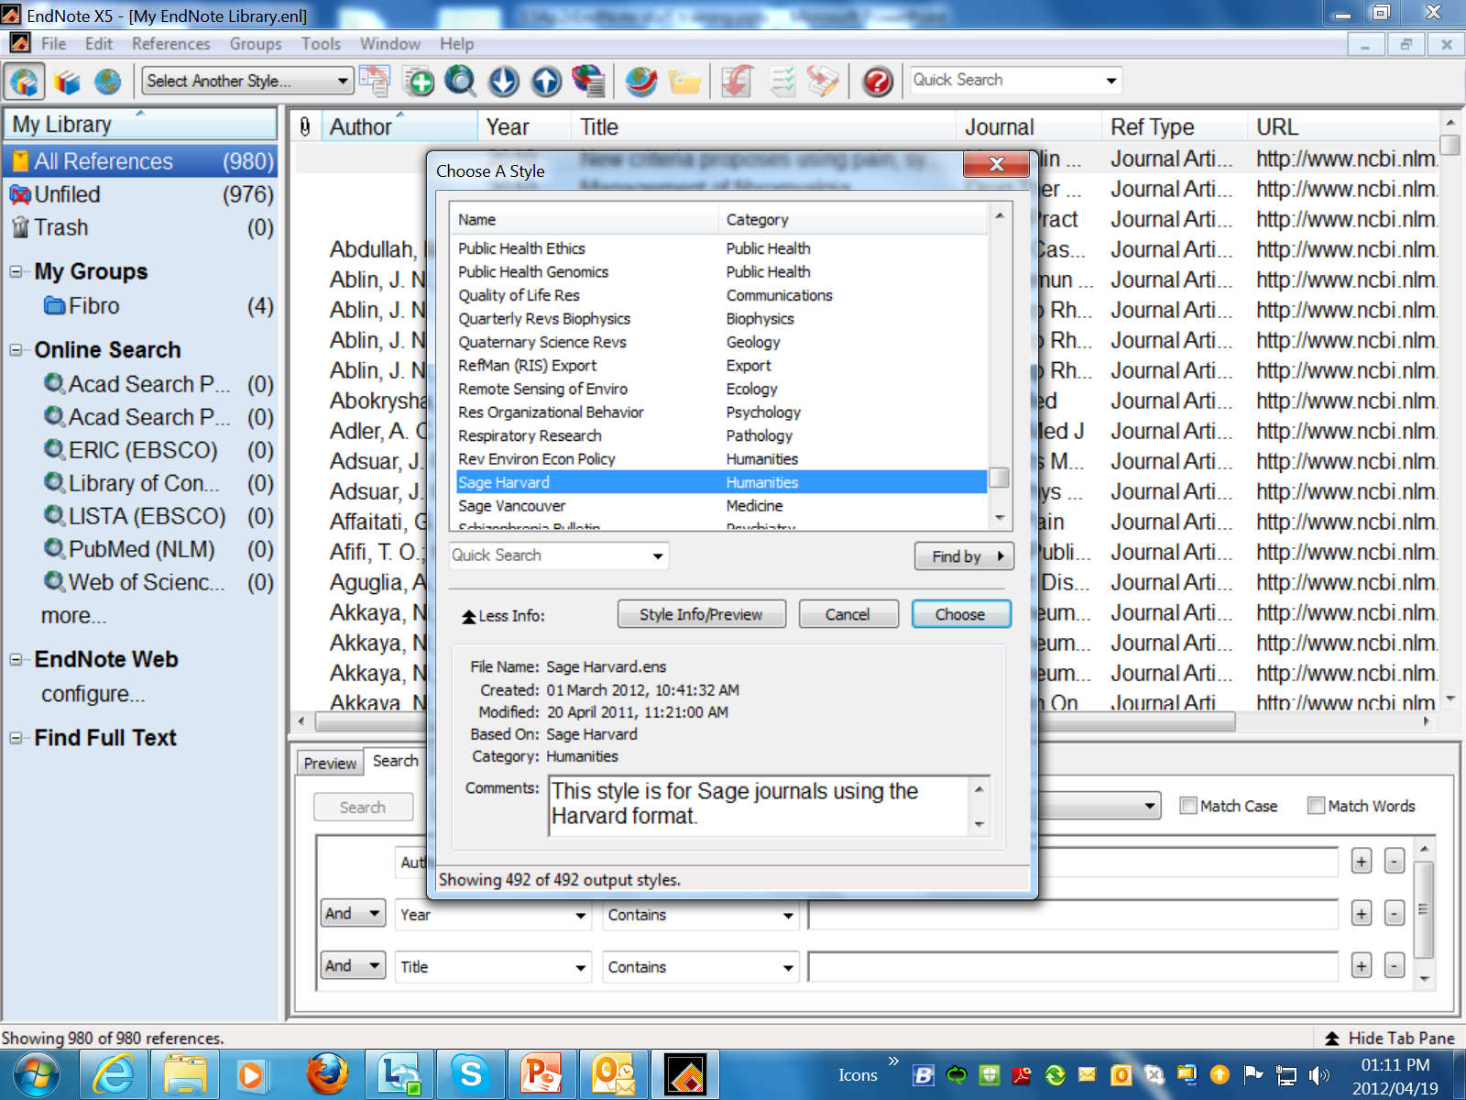
Select the relevant Reference Style

Slide 14
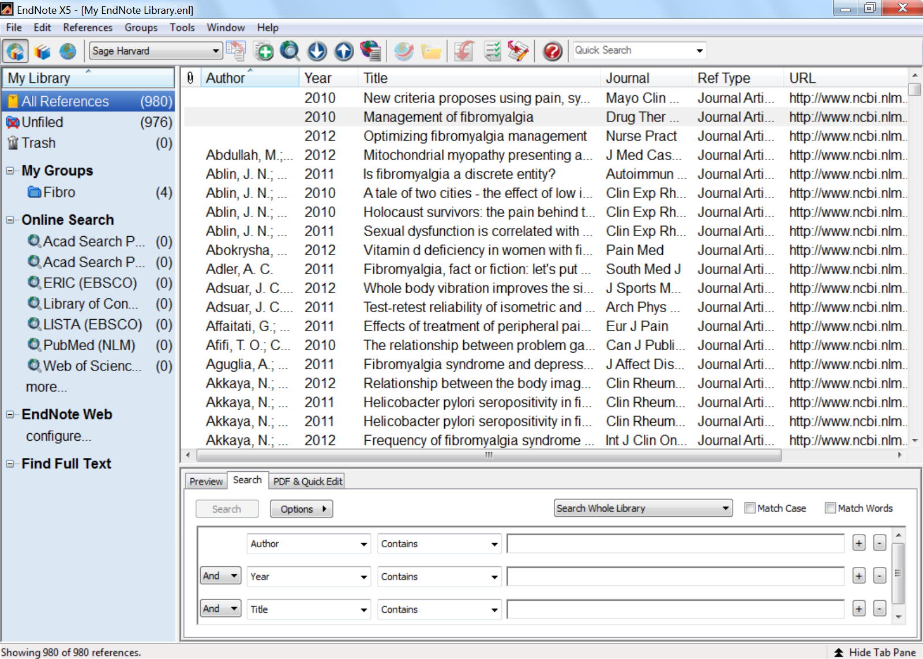
Changed Reference Style
Choose one item from above list and Click on Preview

Slide 15
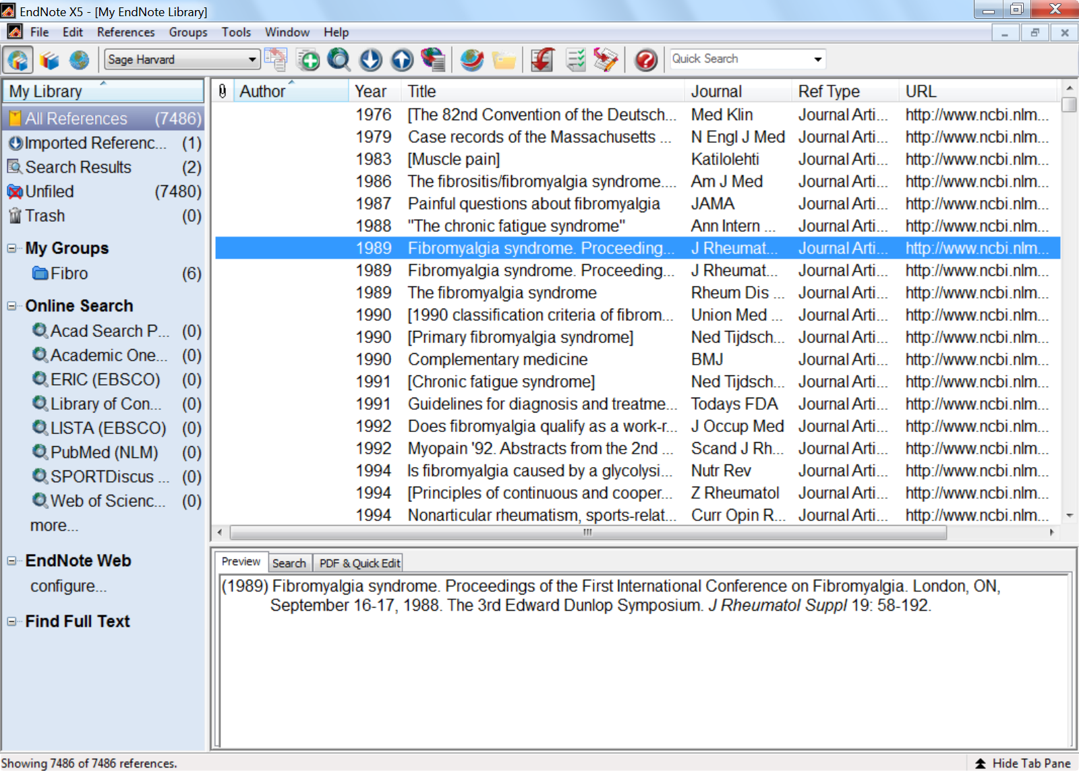
Preview of item in the Reference Style: Sage Harvard

