Slide 1
How to insert page numbers in your citations
Deidre Gerber

Slide 2
Step 1: Open Endnote
Edit & Manage Citation

Slide 3
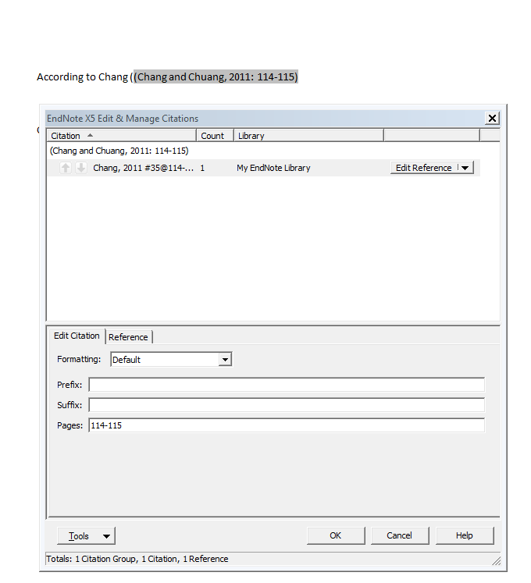
Type in pages
Save

Slide 4
Results

