Slide 1
Getting started with ENDNOTE Compiled by Helene van der Sandt

Slide 2
CONTENTS
Introduction to EndNote
Create an EndNote library
Add references manually
Add references by direct export from databases and Google Scholar
Editing of citations and adding an attachment to citations
Create Groups
Reference Styles
Cite while you Write
Help???????

Slide 3
INTRODUCTION TO ENDNOTE

Slide 4
ENDNOTE X5 LICENSE

Slide 5
BACKGROUND
Library has access to EndNote Web software via ISI Web of Science subscription
A licence to EndNote X5 (desktop) has been secured for the 2012 academic year for the NMMU via the Research Office

Slide 6
ENDNOTE:
Is a commercial reference management software package by Thomson Reuters
Helps you collect, organize and share citations from library databases and catalogues
Helps you format your papers, creating bibliographies, in-cite references and footnotes in a wide variety of citation styles (Chicago, MLA, APA, etc.)

Slide 7
ENDNOTE ON LIBRARY PAGE (www.nmmu.ac.za/library)
Scroll down to see download instructions

Slide 8
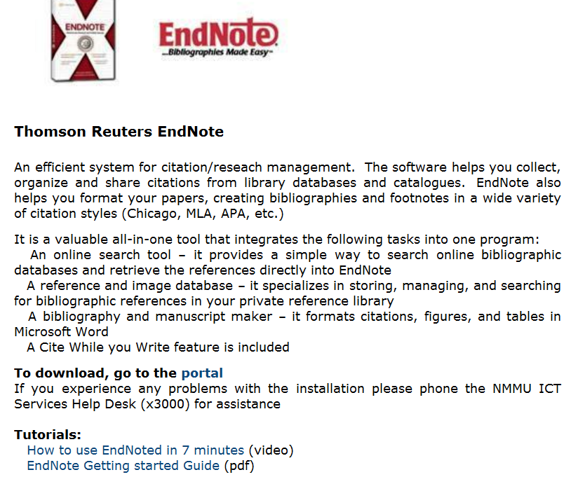
ENDNOTE ON LIBRARY PAGE (www.nmmu.ac.za/library): Download Instructions
Off-campus users will be prompted for their NMMU username and password.
Use Internet Explorer’s latest version 9 to avoid problems with accepting username and password
Students must use their username as follows:
nmmu\s……………

Slide 9
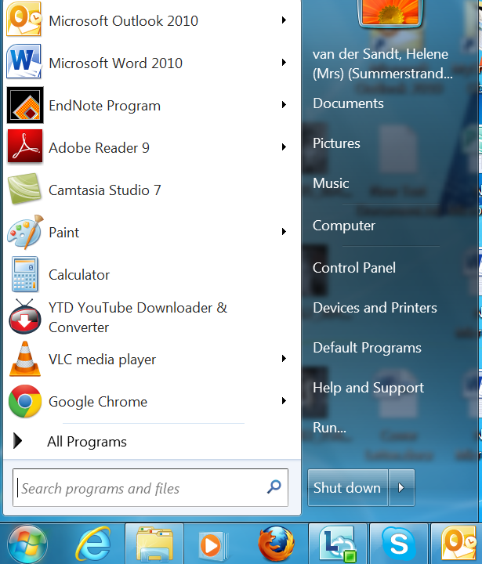
Find EndNote X5 on your computer after you installed it

Slide 10
Optional: You can also create an EndNote Web account

Slide 11
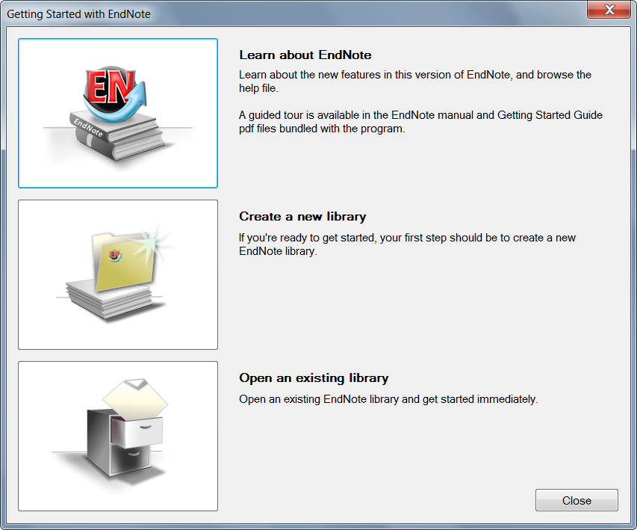
Create a New EndNote Library
The first time you access EndNote you have to:
Click here to create a new library

Slide 12
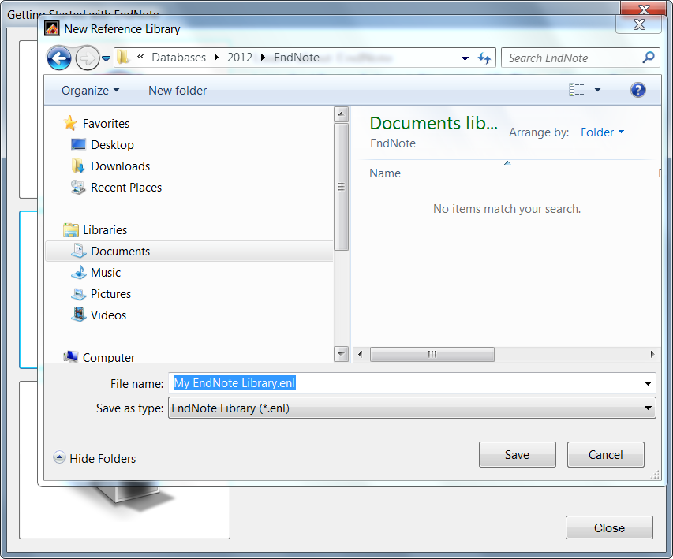
Save EndNote Library on your computer under “My documents”

Slide 13
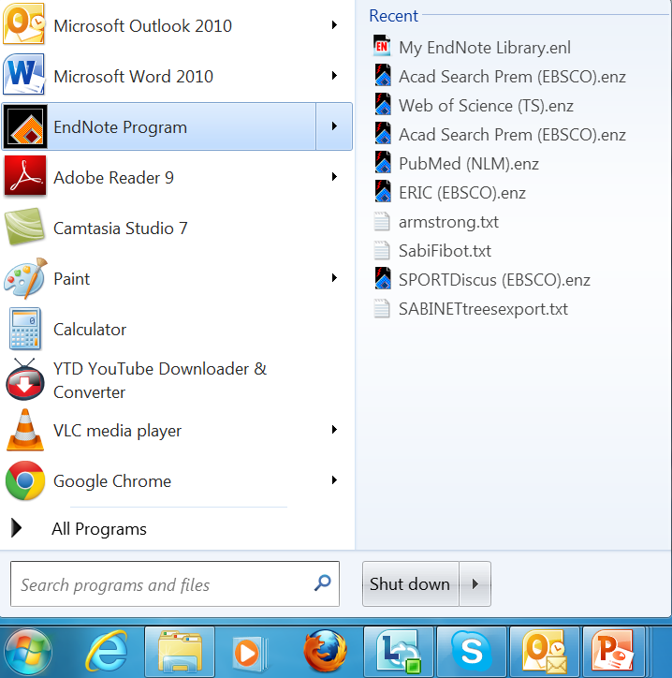
Access to My EndNote Library

Slide 14
You are now ready to use EndNote X5

Slide 15
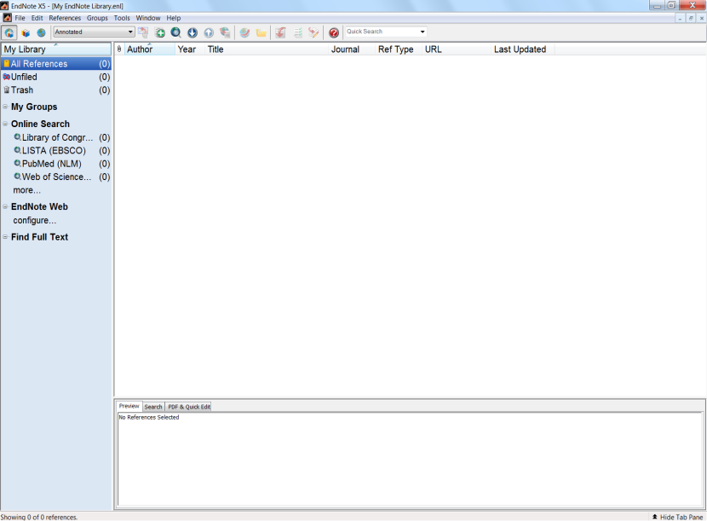
ENDNOTE INTERFACE
Groups pane:
Lists various group sets that contain groups of references for easy retrieval
Reference List Pane:
Displays a multi-column list of references
The EndNote Library window includes three panes:
Reference List
Groups
Tab
Tab pane:
Displays a Preview tab to view formatted references, a Search tab for searching either the current library or an online database and a Quick Edit tab
Notes:
You can choose from different display modes in the Library window. You may want to always work in Integrated Library & Online Search Mode, where all groups and commands are available. When you download references from an online database, they are saved directly into your open library.

